Slide 1
Texas
Voluntary Pooling

Slide 2
The Legacy of the
Rule of Capture

Slide 3
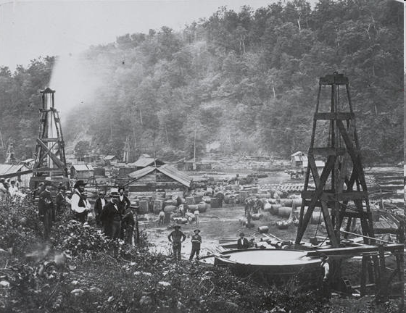
1862 The Phillips and Woodford Wells Titusville, Pa

Slide 4
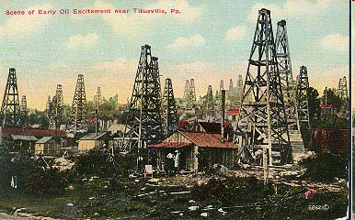
An Early (1860’s) “postcard” of Titusville area

Slide 5
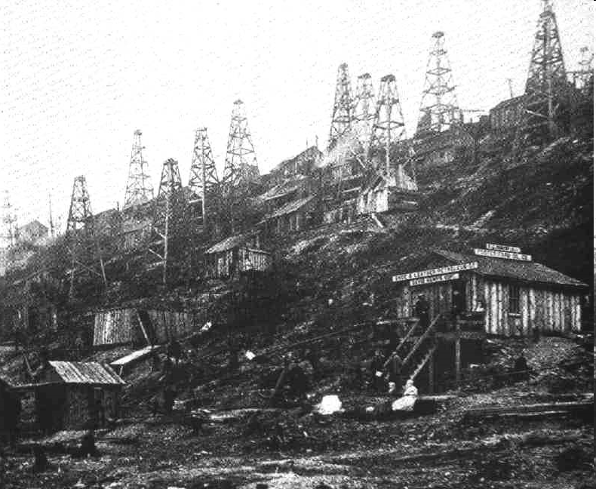
1860’s Bank of Oil Creek

Slide 6
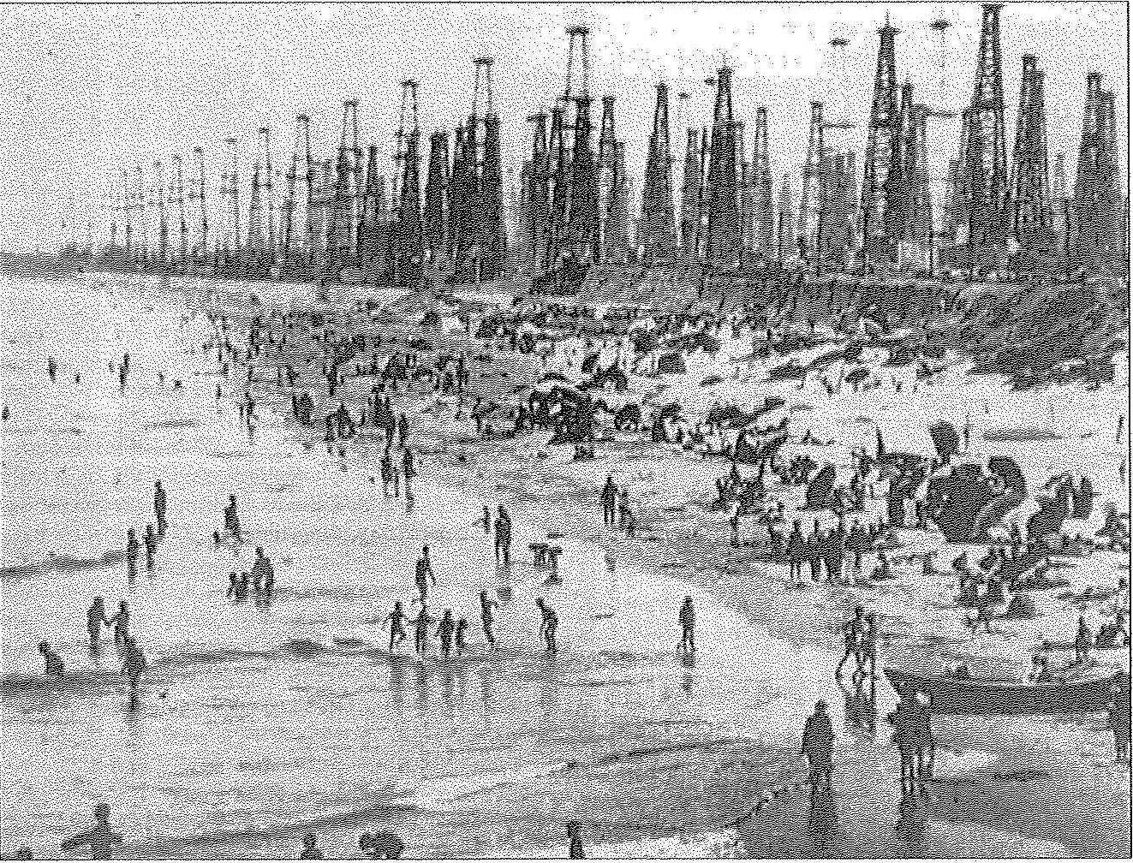
Huntington Beach, CA (1890’s?)

Slide 7
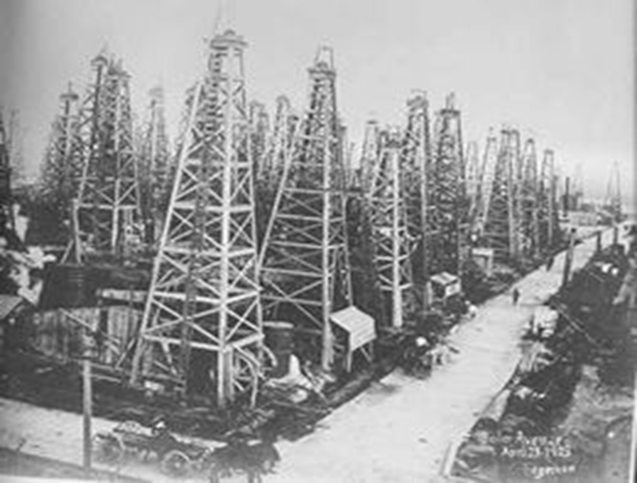
1903 Spindletop's Boiler Avenue

Slide 8
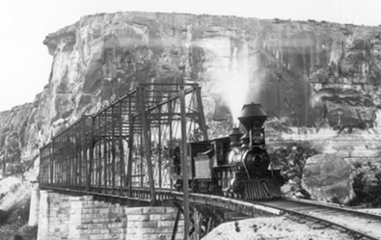
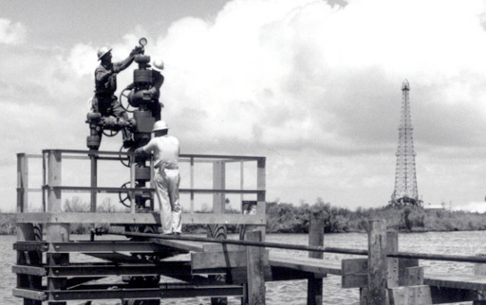
What is the Railroad Commission?
Established in 1891.
Constitutionally and Legislatively created to Regulate Rails.
Currently, Regulates the Oil and Gas Industry.
One of the largest and oldest agencies in the State of Texas.
Creates Rules, Enforces Rules, and Adjudicates Rules.

Slide 9
Your Most Important Resource
http://www.rrc.state.tx.us/

Slide 10
Increasing Jurisdiction
1891 – Private Railroads
1919 – Oil and Gas
1920 – Gas Utilities
1931 – Buses and Trucks
1939 – LPG
1976 – Surface Mining
1991 – Alternative Fuels

Slide 11
Divisions of the Railroad Commission
Surface Mining
Safety
Gas Services
General Counsel
Oil and Gas

Slide 12
The Railroad Commission does not have jurisdiction over roads, traffic, noise, odors, leases, pipeline easements or royalty payments

Slide 13
“…it is well established that the commission does not have jurisdiction to decide disputes over title or rights of possession…Rather, the commission’s authority to grant permits is negative in nature – the commission, through a permit, merely removes a barrier the conservations laws would otherwise impose…” Rosenthal v. Railroad Commission of Texas, et al, 3rd Court of Appeals-Austin, Opinion ID 18426

Slide 14
WELL SPACING (Rule 37)
Lease Line Spacing
Between Well Spacing
16 TAC § 3.37
WELL DENSITY (Rule 38)
Number of acres required to obtain a regular well permit
16 TAC § 3.38

Slide 15
-Unit-
UNIT – A commonly misused word in our business – especially in Texas. (Generally – 16 TAC § 3.38 (Rule 38)

Slide 16
Types of Units
Drilling Unit
Pooled Unit
Proration Unit
Standard Unit
Producing Unit
MIPA Unit
Unitization

Slide 17
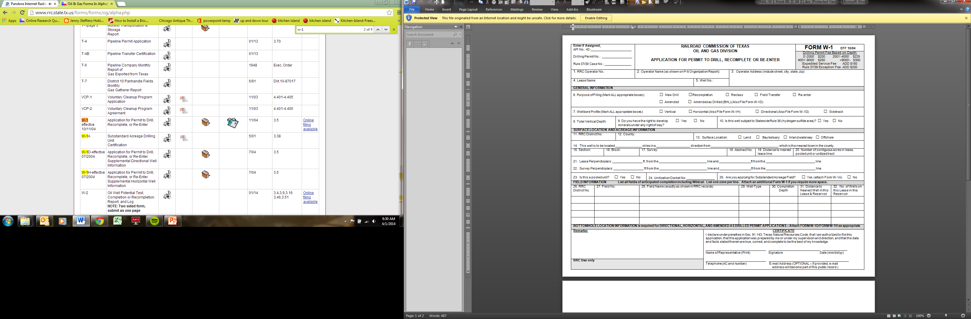
Drilling Unit
The acreage assigned to a well for drilling purposes
  16 TAC § 3.38(a)(2)
Form W-1

Slide 18
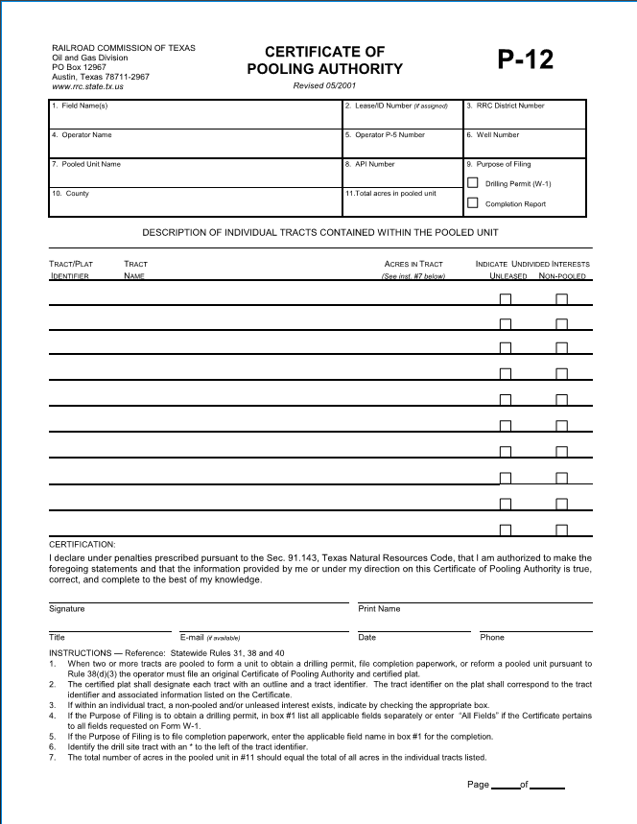
Pooled Unit
A combination of tracts allowed by a lease pooling clause in order to combine sufficient acreage to drill a well.
  16 TAC § 3.40
Form P-12

Slide 19
Aspects of a Pooled Unit
Cross-Conveyancing of interests
Allocation of production – Usually on an acreage basis
Tracts without a well “held” as if a well was drilled on the tract

Slide 20
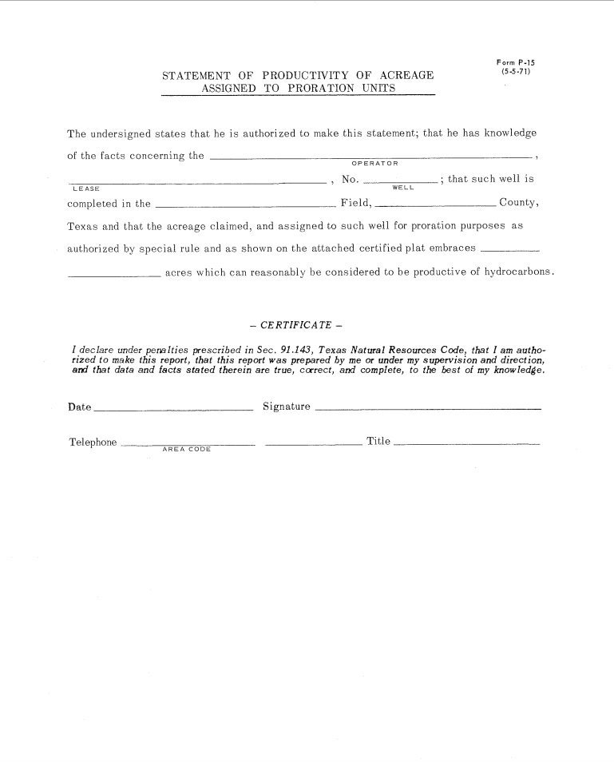
Proration Unit
The acreage assigned to a well for the purpose of assigning allowables and allocating allowable production to the well
  16 TAC § 3.38(a)(3)
Form P-15

Slide 21
Proration unit
BUT – 16 TAC § 3.31(c)(1)
  If an allocation formula with acreage has not been adopted for a field, THERE ARE NO PRORATION UNITS.
  See: Davin McGinnis & H. Phillip Whitworth

Slide 22
Standard Units
The well spacing and drilling unit acreage required to drill a well - Statewide Rules
    16 TAC §3.38(b)(2)(a)

Slide 23
Production Units/Producing Units
Not DEFINED
Do Not Use

Slide 24
MIPA Unit – Forced Pooling
TNRC Chapter 102
The Ammonite/GLO Problem

Slide 25
Unitization
The combination of many tracts with producing wells for the purpose of secondary or tertiary recovery.
TNRC Chapter 101

Slide 26
TYPES OF UNITS
Voluntary Pooled Units
Force Pooled Units
Drilling Units
Proration Units
Fieldwide/Enhanced Recovery Units
Specially Defined Units in the Lease Instruments

Slide 27
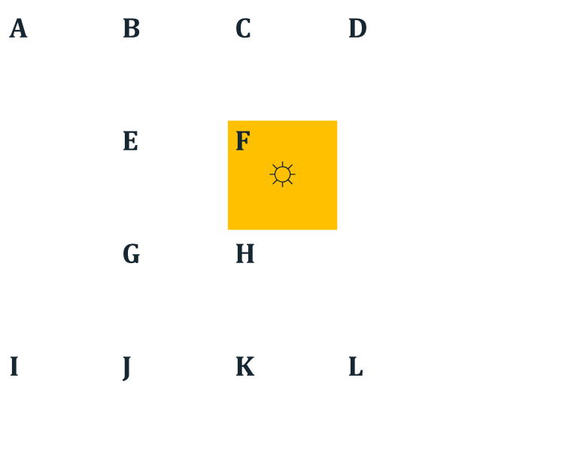
Each separately labeled tract = separate lease
Tract F = 40 acre drilling unit
Tracts C and F = 80 acre proration unit
Tracts B, C, E , F, G, H, J , K = 320 acre voluntary pooled unit
Tracts C, F, 80 acre portion of Tract D = 160 acre force pooled unit
All Tracts (A-L) = fieldwide/enhanced recovery unit
B
C
E
F
G
H
J
K

Slide 28
VOLUNTARY POOLING
Why Pool?
  Avoid drilling unnecessary wells
  Protect each owner’s correlative rights to share in production
  Comply with RRC spacing and density regulations and obtain increased allowable
  Obtain the best geological location
  Maintain leases for future drilling

Slide 29
Authority to Pool
Pooling authority must be granted in the lease or by separate contract.
Texas courts are liberal in recognizing conveyance of pooling authority and in concluding such pooling clauses should not be construed in a narrow or limited manner.
Always start with the lease.

Slide 30
REMEMBER FUNDAMENTAL DISTINCTION
RRC rules (for spacing, density, allocation) do not create pooling authority.
But RRC rules can impact pooling authority
  “governmental authority” clauses – may pool to larger size if necessary for regular permit or full allowable

Slide 31
O&G Lease Pooling Provisions
Many different pooling provisions even in “standard” form leases
Events necessary to trigger pooling authority; e.g.
  for conservation
  avoid unnecessary drilling
  proper development
Don’t assume: read your lease pooling provision and all riders carefully!

Slide 32
Non-Contiguous Lands in Pooled Units
No requirement that pooled units consist of contiguous lands in the absence of express lease provisions to contrary
Special authority from the RRC is required to assign non-contiguous lands to a well for drilling permit or proration/allowable purposes
Window pane tracts

Slide 33
Effect of Changes From Gas to Oil Classification
If no provision in lease, classification change will trigger dissolution of a gas unit.
No second chance if lessee forms a gas unit but completes an oil well

Slide 34
Unpooled Undivided Interests Within Pooled Unit Boundaries
No equitable pooling in Texas
Cost-bearing interests
  Unpooled interests in a drillsite tract share as cotenants
  A cotenant may pool his undivided interest in a non-drillsite tract without the consent of the other cotenants
  Ratification of pooled units by non-drillsite cost-bearing interests

Slide 35
Non-participating royalty interests (NPRI’s)
  “Heads,” I win; “Tails,” you lose.
  NPRI refuses to ratify lease if well located on NPRI’s lease that pooled with other lands/leases.
  NPRI ratifies pooled unit of well located outside of NPRI’s tract.

Slide 36
THE COMMON LAW
A
36

Slide 37
THE COMMON LAW
A
B
37

Slide 38
THE COMMON LAW
A
B
Pay royalty to A and B or B?
38

Slide 39
THE COMMON LAW
Non-Apportionment
A
B
39

Slide 40
THE COMMON LAW
The Non-Apportionment Rule
Japhet v. McRae – Royalty is paid to the drillsite royalty owner only, unless there is:
1. pooling
2. a community lease
3. an entirety clause in the lease
4. a provision in the deed creating a separate tract that requires apportionment

Slide 41
THE COMMON LAW
The Community Lease
1. Definition – One lease executed by the mineral owners of multiple tracts. The lessee is entitled to treat all tracts covered by the lease as a single “leased premises”. Parker v. Parker.
2. Negates the Non-Apportionment Rule by pooling all mineral owners as a matter of law. The non-apportionment result can be defeated by an express contract.

Slide 42
THE COMMON LAW
The Consequence is a Cross-Conveyance?
Veal v. Thomason dealt with determining who were necessary parties in pooling litigation. No Texas case has confirmed that actual title was cross-conveyed.
Cross-conveyance is a theory, not a reality.

Slide 43
THE CONTRACT
A Texas Court will interpret an unambiguous oil and gas lease provision strictly based upon the words actually used, not upon what the parties may have intended but did not express.
Heritage Resources, Inc. v. NationsBank.
Absent express authority, a lessee has no power to pool the lessor’s interest with the interest of others.
Southeastern Pipeline Co. v. Tichacek.

Slide 44
THE CONTRACT
B. A Lessee’s Pooling Authority is limited to the express terms contained in the oil and gas lease. Exxon Corp. v. Atlantic Richfield Co. A typical pooling clause addresses the following issues:
Authority to pool leased land with other lands for the reasons stated.
Identifies acreage limits for pooling for oil and for gas.
Allows “governmental regulation” to increase acres that can be pooled.
The act of pooling requires the lessee to record a written designation of unit in the county of the land leased.
Once the unit designation is recorded, operations and production from the drillsite are considered operations and production from the non-drillsite tracts.
Each royalty owner pooled is entitled to receive royalty based upon the fraction composed of the net mineral acres contained in his tract divided by the total mineral acres pooled.

Slide 45
THE CONTRACT
C. The granting of pooling authority in the lease is interpreted broadly, Tiller v. Fields, but the exercise of that authority is often interpreted strictly, Jones v. Killingsworth. The best solution is a well-drafted pooling clause granting the lessee broad powers and wide discretion. See Texas Exxon Lease attached as Exhibit A.

Slide 46
THE CONTRACT
Entirety Clause – Negates the non-apportionment rule.
Royalty is paid on a lease basis, not a tract basis. Thomas Kilcrease Foundation v. Stanolind Oil & Gas Co. Most current lease forms do not contain an entirety clause.

Slide 47
THE CONTRACT
Pugh Clause/Partial Lease Termination
The rule of indivisibility requires that production from a lease, or from any land pooled with the leased land, maintains the lease in its entirety. Mathews v. Sun Oil Co. A “Pugh clause”, I prefer “lease termination clause”, allows a lease to partially terminate, vertically and/or horizontally, outside of producing acres and formations. Shown v. Getty Oil Company

Slide 48
THE CONTRACT
Retained Acreage Clause.
These clauses are sometimes referred to as retained acreage clauses, Pugh clauses, lease termination clauses, continuous development provisions, or release clauses. The result is that leases partially terminate vertically except for the acreage around a producing well, usually described as the acreage within a proration unit, or the number of acres required to obtain a maximum allowable.
There are no proration units where there are no special field rules or where the allocation formula does not include acreage as a factor. Therefore, in those instances, a retained acreage clause that is based upon retention of the acres within a proration unit would be considered ambiguous.

Slide 49
THE CONTRACT
Retained Acreage Clause.
Do not confuse the acres a lessee can pool, which is determined by the authority granted in the pooling clause of the lease, with the acres the lessee can retain after the completion of the continuous drilling program, which is determined by the retained acreage clause.

Slide 50
THE CONTRACT
Benefits of Successful Pooling
Each lessor relinquishes his right to have his tract developed and to receive all royalties from his tract.
Commencement of drilling and other operations on one tract benefit all tracts, and excuse the payment of delay rentals.
Production on any tract extends the primary term of all leases pooled.
Wells may be located within the pooled unit without respect to the individual property or lease lines and the lessee is relieved of its obligation to drill offset wells within the pooled acreage.

Slide 51
CATASTROPHES
Timely recording perpetuates the non-drillsite tracts.
In the usual event where the pooling clause does not provide the time when the pooling becomes effective, pooling is effective when the pooling instrument is recorded. Sauder v. Frey. If the pooling clause does not require that it be recorded, it is effective upon execution. Tiller v. Fields. I recommend that the pooling clause state that it is effective upon the date provided in the pooling instrument.

Slide 52
CATASTROPHES
Designation of Unit must be executed by the person authorized.
The only person expressly authorized is the lessee. If someone other than the lessee executes the pooling instruments, the pooling instrument should reflect that the third party is acting as the agent for a lessee. Pampell Interest, Inc. v. Woole.

Slide 53
CATASTROPHES
Government Regulations may “prescribe” and/or “permit”.
Field Rules sometimes provide that they “prescribe” (require) so many acres be attributed to a well, while the lessee is “permitted” (allowed) to attribute additional acreage to a well. Be aware that many pooling clauses allow the lessee to pool as “prescribed” by the RRC, but not as “permitted” by the RRC.
Jones v. Killingsworth

Slide 54
CATASTROPHES
Some “good faith/bad faith” issues.
Cannot include condemned land. Amoco Production Co. v. Underwood.
Cannot gerrymander. Circle Dot Ranch, Inc. v. Sidwell Oil & Gas, Inc.,
Cannot ignore geology. Elliott v. Davis.

Slide 55
CATASTROPHES
Duty of mineral owner/lessee to unleased mineral owner.
Drillsite tract – carry unleased mineral owner in drillsite until payout. Superior Oil Co. v. Roberts.
Non-drillsite tract – can be ignored after well completed. Fletcher v. Ricks Exploration.
No duty to offer unleased mineral owner right to participate in a pooled unit. Donnan v. Atlantic Richfield.

Slide 56
CATASTROPHES
Duty to drillsite NRPO
Cannot be pooled without owners consent. Brown v. Smith. Can ratify lease or pooling agreement, or not ratify anything, based upon its own self interest. MCZ, Inc. v. Triolo.

Slide 57
CATASTROPHES
Duty to Non-Drillsite NPRO.
Allowed to ratify at any time. May or may not receive proceeds from first production. DeBenavides v. Warren.
NPRO nearly always wins.

Slide 58
CALCULATING ROYALTY WHERE NPRI IN DRILLSITE
Lease – 3/16 R
NPRI of 1/16 of O&G
in drillsite
No Ratification
MO – 3/16 x ¼ (TF) = 3/64
NPRI – 1/16 x 8/8 = 4/64
R paid to MO = 0
Ratification
MO – 3/16 of ¼ (TF) = 3/64
NPRI – 1/16 of ¼ (TF) = 1/64
R paid to MO 2/64
•

Slide 59
CALCULATING ROYALTY WHERE NPRI IN DRILLSITE
Lease – 3/16 R
NRPI of 1/16 of the R
in drillsite
No Ratification
MO – 3/16 x ¼ (TF) = 3/64
NPRI – 1/16 x 3/16 = 3/256
R paid to MO – 3/64 (-) 9/256
12/256 (3/64)
Ratification
MO – 3/16 of ¼ (TF) = 3/64
NPRI – 1/16 of 3/64 = 3/1024
R paid to MO – 15/16 of 3/64 = 45/1024
48/1024 (3/64)
•
59

Slide 60
Horizontal Drilling
Railroad Commission Rules
Statewide Rules
Or
Special Field Rules

Slide 61
WELL SPACING (Rule 37)
Lease Line Spacing
Between Well Spacing
WELL DENSITY (Rule 38)
Number of acres required to obtain a regular well permit

Slide 62
Lease line Spacing
467’ = Statewide Spacing Rule
330’ = Typical Shale Rule
    Barnett Shale
    Eagle Ford
    Haynesville
467’’
467’

Slide 63
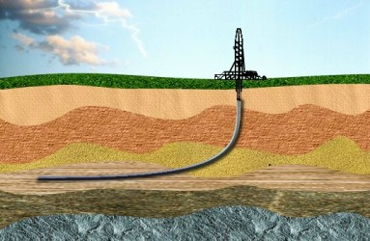
LEASE SPACING (PER RULE 86)
Surface Hole Location
(Per Rule 86)
467’
T
Terminus
467’
467’
Bottom Hole Location
PP
Penetration Point
467’
Horizontal Well
467’

Slide 64
BETWEEN WELL SPACING
Vertical
Horizontal
467’
467’
467’
BHL
BHL
467’
1200’ = Statewide b/w Well Spacing
0’ in Spraberry
0’ in Most Shales
1200’
1200’
467’
467’

Slide 65
-Warning-
Rule 37(e)
  “No well drilled in violation of this section without special permit obtained, issued, or granted in the manner prescribed in said section, and no well drilled under such special permit or on the commission's own order which does not conform in all respects to the terms of such permit shall be permitted to produce either oil, gas, or geothermal resources and any such well so drilled in violation of said section or on the commission's own order shall be plugged. “

Slide 66
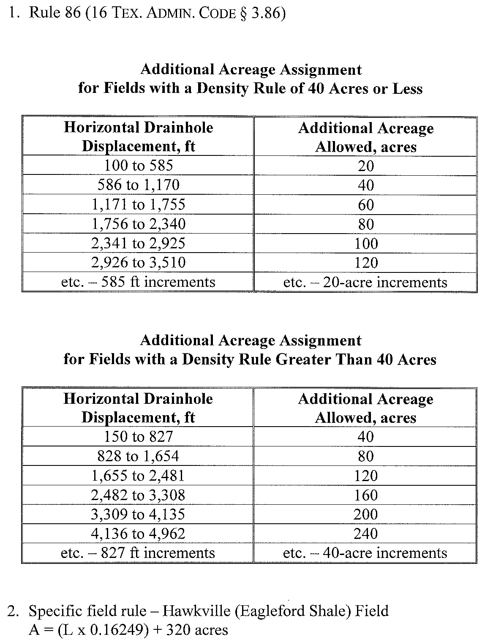
Additional Acreage Assigned
Spraberry
80+80+240 = 400 ac.
Barnett Shale
320+32+240 = 592ac.
Sugarkane
(4200 x 0.2) + 320 = 1160
4200’ Lateral

Slide 67
Horizontal terms (rule 86(a)(1-6))
(1) Correlative interval--The depth interval designated by the field rules, by new field designation, or, where a correlative interval has not been designated by the commission, by other evidence submitted by the operator showing the producing interval for the field in which the horizontal drainhole is completed.
(2) Horizontal drainhole--That portion of the wellbore drilled in the correlative interval, between the penetration point and the terminus.
(3) Horizontal drainhole displacement--The calculated horizontal displacement of the horizontal drainhole from the penetration point to the terminus.
(4) Horizontal drainhole well--Any well that is developed with one or more horizontal drainholes having a horizontal drainhole displacement of at least 100 feet.
(5) Penetration point--The point where the drainhole penetrates the top of the correlative interval.
(6) Terminus--The farthest point required to be surveyed along the horizontal drainhole from the penetration point and within the correlative interval.

Slide 68
MINERAL INTEREST POOLING ACT
(MIPA)

Slide 69
OVERVIEW
Force Pooling Is Based On The Mineral Interest Pooling Act (“MIPA”) Enacted In 1965 But Effective March 8, 1961
Purposes Of MIPA Is To Protect Correlative Rights, Prevent Waste Or Prevent Drilling Of Unnecessary Well
Texas Statute Is Unique
  Designed To Encourage Voluntary Pooling Before Going To Commission
Prerequisite For Force Pooling- Fair And Reasonable Voluntary Offer To Pool Which Has Not Been Accepted

Slide 70
MAY I FORCE POOL?
PREREQUISITES TO FORCE POOLING
Established Field
  No Wildcat Pooling
Discovery Date of Field after 3/8/1961
Special Field Rules
No State Lands Without Consent
Two or More Tracts
Common Reservoir or Consolidated Field
Existing or Proposed Well

Slide 71
MAY I FORCE POOL?
PREREQUISITES TO FORCE POOLING (CONTINUED)
Unit Size Limited
  160 acres for oil well
  650 acres + 10% tolerance for gas well
  Horizontal wells not contemplated
Achieve Statutory Purpose
  Avoid drilling of unnecessary wells
  Protect correlative rights
  Prevent waste
Voluntary Offer to Pool

Slide 72
PARTIES WHO MAY SEEK TO FORCE POOL
Authorized Force Pooling Applicants
  Existing Proration Unit-Any Owner including Royalty Owners
  Proposed Unit – Only Possessory Mineral Owners
School Land Board Has Standing to Force Pool Unleased Riverbeds and Channels
  GLO/Ammonite actively pursuing force pooling of unleased riverbeds into adjacent production
  80+ applications filed – 200 more identified

Slide 73
VOLUNTARY POOLING OFFER
Requirement Unique to Texas Law
Jurisdictional Prerequisite for Force Pooling
Elements –Carson v. RRC held that
  A fair and reasonable pooling offer takes into account relevant factors important to…
  A “reasonable person” in the position of the offeree
RRC Liberally Construes What Constitutes a
Fair and Reasonable Offer
  RRC legal staff recently followed stricter interpretation

Slide 74
Unfair Offers
All or none in a proposed 8 well development
For dual completion, no apportionment of costs and interest between zones
Attaching form JOA without blanks filled in to offer
Pooling drillsite royalty on same yardstick basis as others in pooled unit after well drilled
  Carson v. RRC rejected MIPA standard for existing proration units
Pooling for a reservoir from which existing well is not currently producing

Slide 75
Fair Offers
Risk Penalty Not Required
Drainage of Specific Acreage in Unit Not Required-Only Equivalent
Timing- Not an Issue If Made Before Hearing
Statutory-Participation on Same Yardstick Basis as Others in an Existing Unit –Except for Carson facts
Pool, Lease or Farmout for Residential Lots
Whether Offer to Lease Is Offer to Pool

Slide 76
ACREAGE SUBJECT
TO FORCE POOLING
MIPA Limits Pooling to Acreage that Is Productive at the Time of Final Order
But Determination of Productive Acreage Based on the Evidence at the Hearing- Not Updated
Applies Even for Water Drive Reservoirs with Changing Productive Limits

Slide 77
Finley Resources Case Expands
Traditional Application of MIPA
Background Facts
  Finley leased and pooled 90.616 acres (300 + lots) in urban subdivision of Ft. Worth.
  Horizontal well needed to produce Barnett Shale hydrocarbons.
  Trespass issues caused by 5.704 acres (26 lots) of unfindable or non-responsive unleased owners prevent drilling of well.

Slide 78
Figure 3
  Finley made voluntary offer to unleased owners – lease, pool or farmout for 96.32 acre MIPA unit.
  No party appeared at hearing to protest.

Slide 79
Finley Resources Case Expands
Traditional Application of MIPA (continued)
Opposing Positions
  Finley: MIPA Unit necessary to drill well to prevent waste, protect correlative rights of working interests and 100’s of royalty owners and to prevent drilling unnecessary wells.
  Examiners: MIPA limited to protect small tracts, not to give large tract lessees more flexibility in development.
RRC Granted MIPA Application
  Action 1+ years after Finley filed application.
  Granted force pooled parties 1/5 royalty and carried 4/5 working interest.

Slide 80
Finley Resources Case Expands
Traditional Application of MIPA (continued)
Significance of Finley Decision
  Remedy for operators to drill wells over objection of unleased/unfindable parties refusing to lease or pool.
  Threat of force pooling encourages good faith negotiations – MIPA cases are burdensome for all parties.

Slide 81
CONCLUSIONS
MIPA May Have Been Historically Effective To Promote Its Overriding Purpose To Encourage Voluntary Pooling.
This Result Not Applicable For Unfindable/ Unidentifiable or Unresponsive Owners.
Finley Decision Is An Antidote For This Problem.
Threat of MIPA Action For Proposed Wells Should Encourage Non-responsive Owners To Negotiate.
MIPA May be Used to Assist In Drilling Wells Previously Undrillable.

Slide 82
In An Election Year,
Support the oil and gas Industry
Learn
Listen
Lampoon/Harpoon

Slide 83
THANK YOU
QUESTIONS?
George Snell
Steptoe & Johnson PLLC
george.snell@steptoe-johnson.com

