Slide 1
I In Celebration of 75 Years of Oil & Gas Conservation in Arkansas Sexy Oil and Gas Conservation Law: Where It’s Been, Where It’s At, and Where It’s Going
Owen L. Anderson
Eugene Kuntz Chair in Oil, Gas & Natural Resources
George Lynn Cross Research Professor
Academic Director, John B Turner LLM and Graduate Programs in Energy, Natural Resource & Indigenous Peoples
The University of Oklahoma College of Law
Notes:
I had planned to talk about Arkansas oil conservation history but noticed other intended to do so too, so I changed my topic to a more broad-based consideration of conservation accidents, policies, cartels, law, and regulation

Slide 2
Where It’s Been
Notes:
Conservation has been around for some time—albeit perhaps inadvertently.

Slide 3
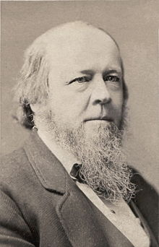
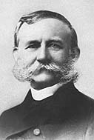
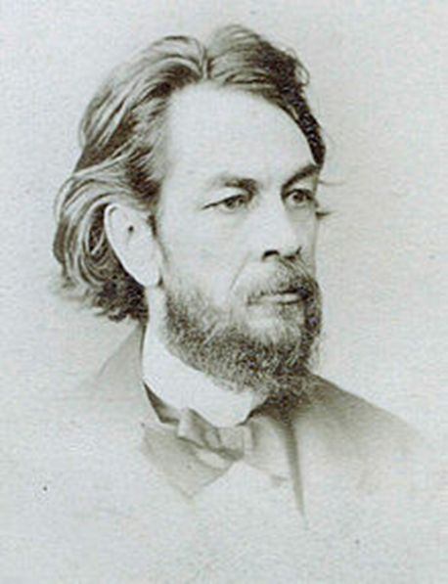
Liquid Lighting Fuels 1850s
Whale Oil burned clean but was increasingly expensive
Coal Oil was less expensive but burned dirty
Kerosene, developed in 1854 by Benjamin Silliman, a Yale Chemist, for investors George Bissell, an New York lawyer and James Townsend, a New Haven banker, burned clean was initially expensive due to scarcity of “rock oil”
Silliman
Silliman
Townsend
Bissell
Townsend
Bissell

Slide 4
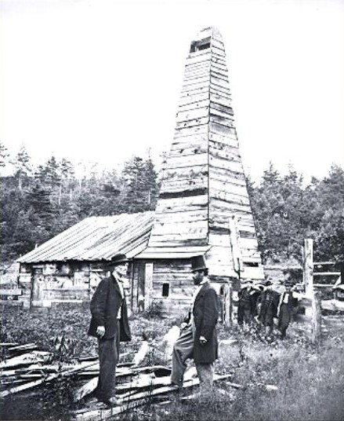
“Col.” Edwin Drake (top hat)
Titusville, Pennsylvania
1859
Pennsylvania Rock Oil Co., George Bissell &
James Townsend, Investors
Notes:
Depth of 59 feet (less than 20 meters)
Provided more plentiful supply of crude oil for refining into kerosene

Slide 5
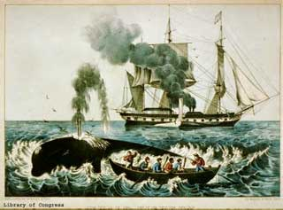


Slide 6
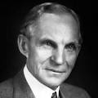
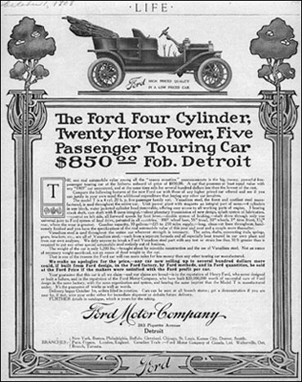
Automobiles
Henry Ford in US makes cars affordable to general population with Model T (1908)
Saved oil industry from Edison’s electric light

Slide 7
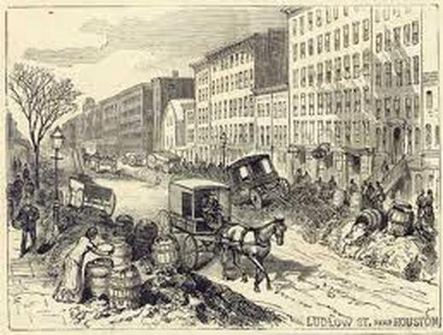
Internal combustion engine and gasoline solves horse-manure pollution problem in cities
Piles of Horse Manure in New York City

Slide 8
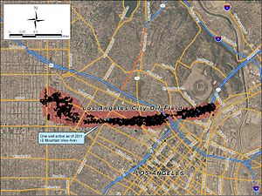
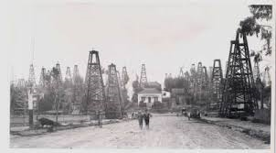
But Oil Conservation Law was late to the dance!
Notes:
The Los Angeles City Oil Field is a large oil field north of Downtown Los Angeles
It is located just south of present-day Dodger Stadium and runs west to Vermont Avenue, encompassing an historical productive area of 780 acres.
Discovered in 1890, it became famous after Edward Doheny drilled the first truly successful well in 1892, using the sharpened end of Eucalyptus tree.
By 1897, 500 wells had been drilled in the field, a 1.5 acre well density.
Ultimately, about 1250 wells have been drilled in this field.
As of 2011 one producing well remained, producing about 3.5 barrels of oil per day.
One of over 400,000 marginal or “stripper” wells that, prior to the oil shale boom of the last 6 years, together accounted for over 15% of US onshore production—an astonishing figure when one considers that the US is the 3rd largest producer of conventional oil in the world.
A major objective of state conservation law has been to keep stripper wells in production for as long as possible.
In some localities, this may not result in the highest and best use of land, but it is hard to quarrel with the strategic importance of America’s combined marginal well production.

Slide 9
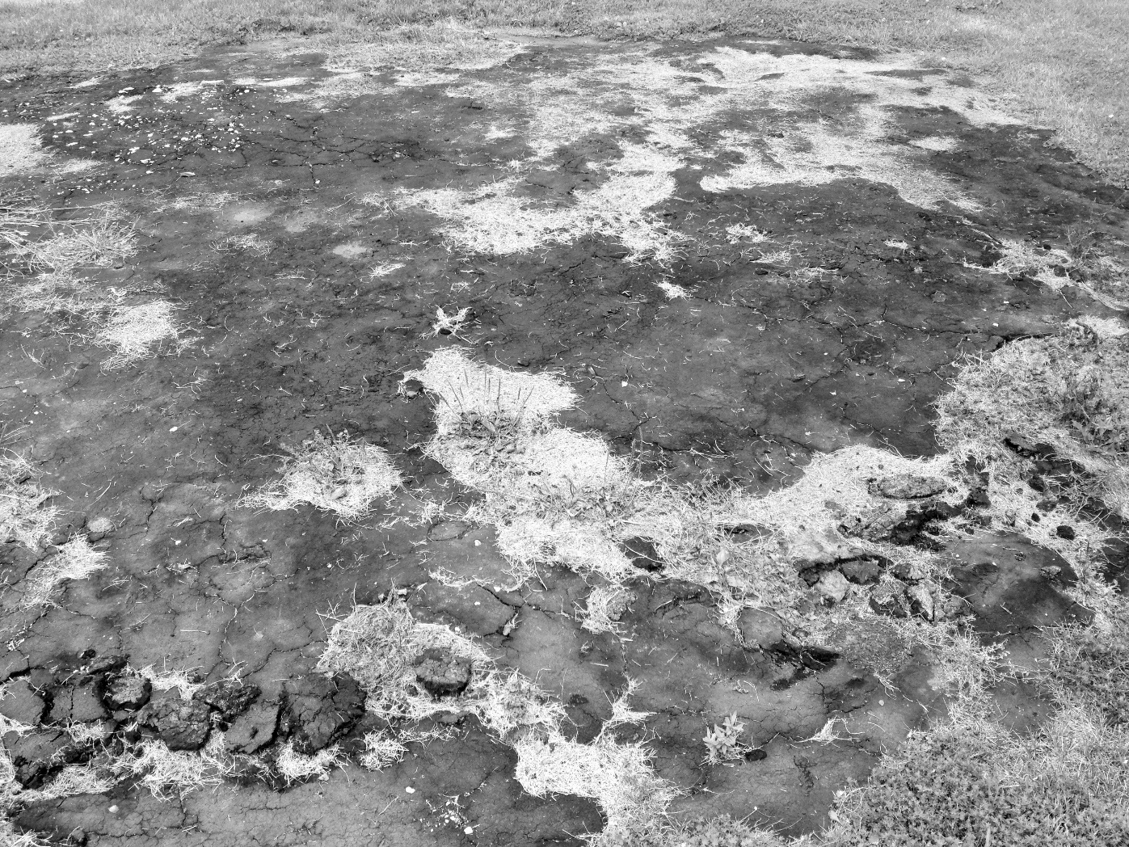
“Up from the ground came the bubblin’ crude!”
Notes:
The Los Angeles City Oil Field was originally discovered as a result of oil seeps at the surface.

Slide 10
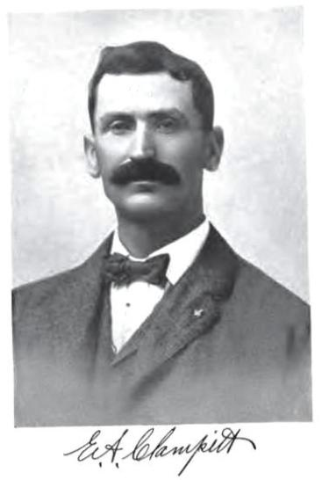
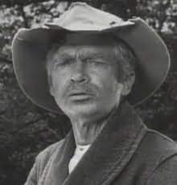

Edward A. Clampitt
Edward A. Clampitt
Jed Clampett
Elly May Clampett
Notes:
When I was gathering information on the Los Angeles City Oil Field, I read that a fellow named Edward A. Clampitt became one of the principal operators Field in the first decade of the 20th century.

Slide 11
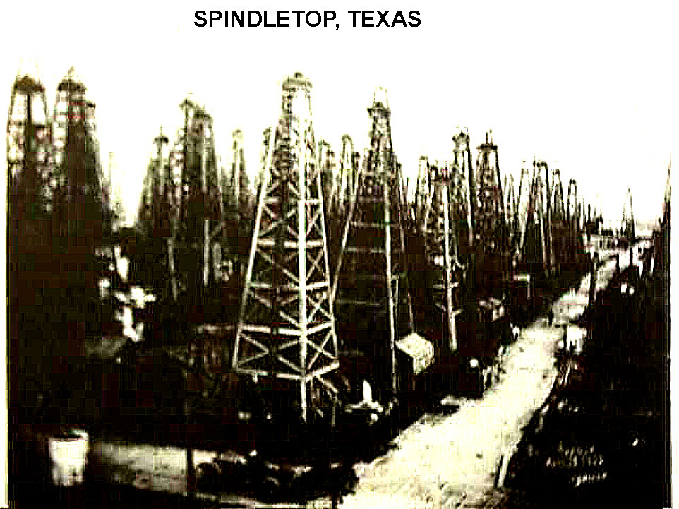
(1903)
Notes:
Spindeltop: Location of the first real gusher of oil. This discovery well was drilled in 1901 and gushed 75,000 to 100,000 barrels per day for several weeks before it was brought under control. This is what the heart of the field looked like in 1903.
In keeping with common practice, if not belief, the accepted notion was “more wells, more oil”—thanks in part to wild-animal analogies used to describe the presumed random movement of oil and gas beneath the surface.
In Spindetop, however, the field was abandoned in 1908.
Some petroleum operators believed that the field had been milked to hard, but the now generally understood need to conserve reservoir pressure is still decades away.
But the surface waste of oil was understood when pools of produced oil that had been stored behind earthen dams caught fire, destroying thousands of barrels of oil.
But Spindletop is the “poster child” for a primary concern of oil and gas conservation law—the prevention of waste:
Drilling more wells than are needed.
Causing surface, underground, and economic waste—concerns that ran counter to the common thinking of the time that more wells meant more oil.

Slide 12
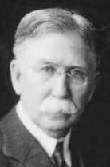
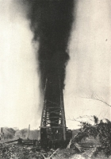
Conservation was late to the dance!
Edward Doheny
Cerro Azul No. 4
Notes:
Edward Deheny was famous for more than Los Angeles City Oil Field.
After selling his interests in the Los Angeles Field in 1902, he drilled for oil near Tampico, Mexico, and developed Mexico’s Golden Lane, building Pan American Petroeleum & Transport Company, one of the largest oil companies in the world in the 1920s.
In 1916, he drilled Cerro Azul No. 4 well, which became the world's largest producing well, pumping 260,000 barrels per day (B.P.D.), shooting oil 598 feet into the air and saturating the ground with oil in a two-mile radius around the well.
No doubt a cause of breaking out Champagne and celebrating. My how times have changed. Now lawyers would be scurrying to assess possible environmental damage and liability.
We now think of surface waste as being more than wasting oil, but also doing environmental harm to soil as well as surface and ground water.
[An interesting sidebar about this early development in Mexico is that it occurred on the American model of private ownership of mineral rights.]
Also, it is appropriate to mention Mexico here today, because Mexico is likely to be the next big oil and gas story in the next few years, as the government invites foreign direct investment in new oil exploration for the first time in over 75 years after expelling most of the private oil companies in 1938 over a labor dispute that blew up into a huge issue of Mexican sovereignty over its oil and gas resources.

Slide 13
1910s: The growing strategic importance of oil and a concern that world supplies were running out, led to what might be loosely termed “conservation policies”
President Taft withdrew federal acreage from oil placer locations in 1909
Great Britain took 51% stake in Anglo-Persian (now BP) in 1914
Also concerns arose about access to what was left
Mexico Revolution (1910 – 1920)
Mex. Const. Art. 27 declares sovereignty over petroleum resources
Russian revolution 1917
Ultimately, leads to loss of assets by Royal Dutch Shell, Nobels, and “Jersey”
Notes:
Concern over oil shortages and security of supply
Access, part of what is commonly called energy security, is a serious concern today.
World War I (1914 – 1918) proved the strategic importance of oil
Mechanized warfare
British and US Navies burn oil, not coal, making ships faster and more agile than German ships

Slide 14
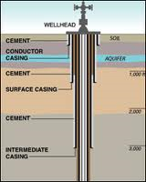
1915: Early Conservation Law
California requires oil and gas operators to run surface casing below freshwater zones and cemented in place—
Notes:
Done more to protect the oil from the water!
But today proper casing and cementing is a basic feature of oil and gas conservation regulation.
The Macondo blowout stands as a recent example of what can go wrong if casing is not properly cemented in place.

Slide 15
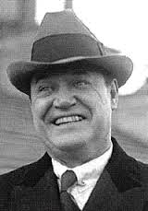
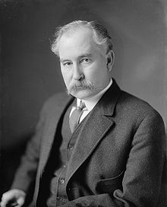
Conservation for national security
Edward Doheny
Henry Sinclair
Albert B. Faul
Notes:
Naval reserves had been established in Wyoming and California to “conserve” oil supplies for the United States Navy.
During the Harding Administration, management of these Naval Reserves were transferred from the War Department to the Department of the Interior.
Edward Doheny and fellow oilman, Henry Sinclair, bribed Albert Faul, Secretary of the Interior under President Warren G. Harding to get oil and gas leases to portions of these naval oil reserves, leading to the famous Teapot Dome Scandal, which became a national symbol for government corruption.

Slide 16
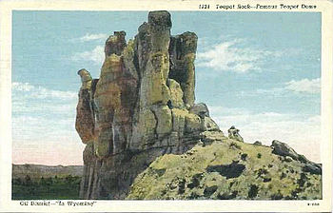
Notes:
Unfortunately the spout on the teapot as fallen down, so the teapot dome looks even less like a teapot than it does in the old post card.
Managing corrupt government officials is a major concern of today’s oil and gas industry.

Slide 17
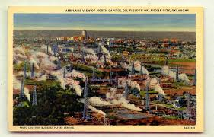
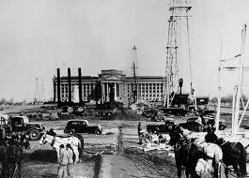
Oklahoma City Oilfield
Discovered in 1928 and entered city limits in 1930
Led to well density ordinance of 1 well per city block
Notes:
Special local regulation of well density and drilling is still in place in OKC
Density and spacing regulation later become a mainstay of state oil and gas regulation in the USA
Tension between local and state regulation
A major issue issue today in NY, PA, CO, and some other states.
The recent IOGCC Model Conservation Act recognizes this tension with alternative versions of the Act, one which preempts all local law except zoning and one that recognizes the possibility of additional local regulation

Slide 18
1920s World-wide Oil Discoveries
New discoveries in various parts of the world between 1900 and 1928 raised a concern of oversupply—at least in the short term
Numerous discoveries in Texas and Oklahoma
Persia in 1908
Mexico in 1910
Arkansas in 1921 and 1922
Venezuela 1922 (some lesser discoveries in 1910s as well)
West Texas 1923 (University of Texas trust lands)
Oklahoma City 1928
Iraq 1928
Notes:
Competing concerns raise the general conservation theme:
We are running out of oil, so we need to conserve it.
We have a short-term oil supplies, so we need to conserve it.

Slide 19
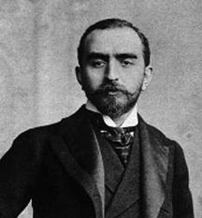
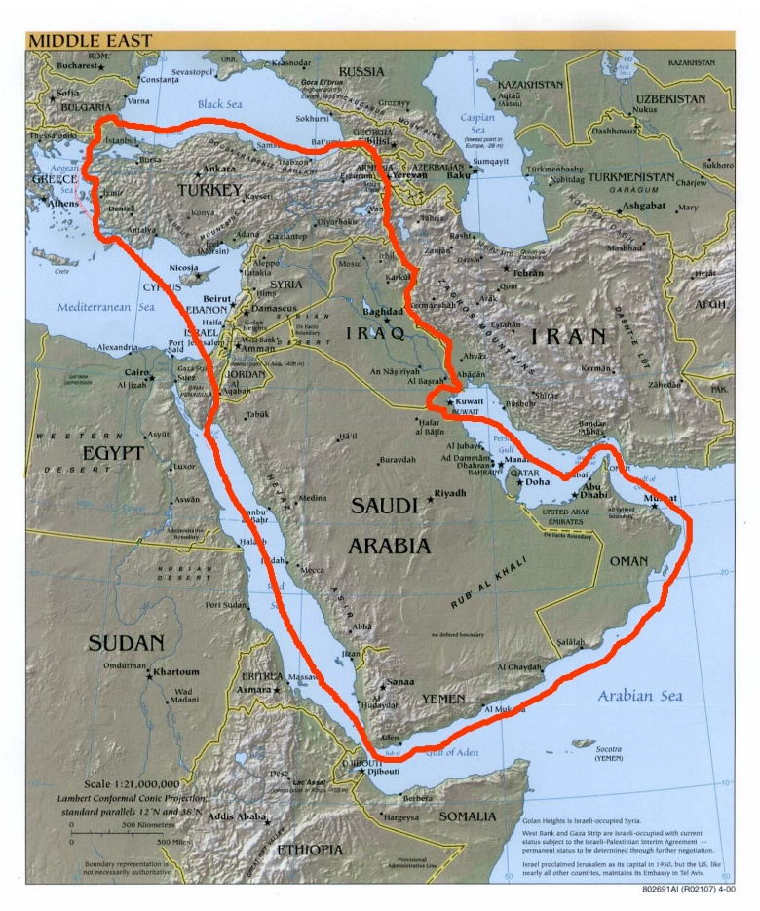
Conservation by Cartel: The Red Line Agreement, 1928
Part of a larger agreement brokered by Calouste Gulbenkian to organize the Turkish Petroleum Co. (Iraq Petroleum Co.), a consortium of companies whose modern names are BP, Exxon, Total, and Shell
The Red Line portion of the agreement prohibited the parties from independently developing oil in the ex-Ottoman empire
Mr. 5%
The Red Line
Notes:
The discovery of a large oil reserves, especially those in Iraq provided the impetus for the infamous "Red Line Agreement.“
This agreement determined what oil companies could invest in the Iraq discovery, through participation in the Turkish Petroleum Co., renamed the Iraq Petroleum Co. in 1929.
Gulbenkian, who brokered the deal, received 5% of the shares in new consortium.

Slide 20
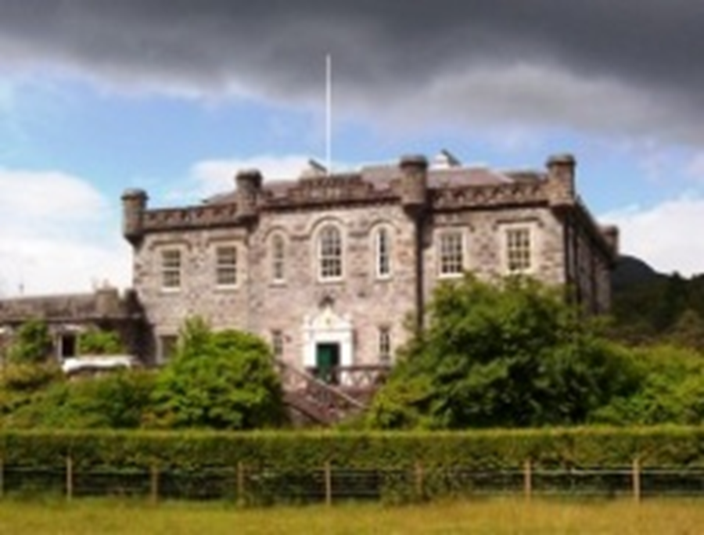
Conservation by Cartel: The “As Is” Agreement, 1928
Product of a secret meeting, disguised as a “golf outing,” at Achnacarry Castle, Scotland, between what we now know as BP, Royal Dutch Shell, and Exxon
Agreement to limit excessive competition by price fixing and locking in market shares
Notes:
Price wars among major oil companies in the 1920s, most significantly in India, threatened profits, especially profits from relatively high-cost production in the United States.
At Achnacarry Castle in the Scottish Highlands, Anglo-Persian Oil Company (later BP), Royal Dutch Shell, and Standard Oil of New Jersey (later Exxon) made an “as is” agreement.
“Principles" to limit "excessive competition" that had led to enormous overproduction by dividing markets, fixing prices, and limiting the expansion of production capacity.
This strategy was implemented as a "basing-point" system that assured that all sellers quoted the same prices.
The As-Is Agreement was substantially responsible for the reluctance of IOCs to expand production in the Middle East.
In 1928, when it was adopted, more than a third of worldwide production capacity was shut down due to oversupply.
Oil companies feared that expanding low-cost capacity in the Persian Gulf would only add to their losses.
The As-Is and Red Line agreements slowed development of Middle Eastern oil resources until after World War II and simultaneously accelerated depletion in the United States and Canada.
When the terms of the Red Line and As Is agreements surfaced, it aggravated anticolonial and anti-Western feelings among the populations of many Middle Eastern states, most notably Iraq and Iran.
It also provided a model for exercising market control later emulated by OPEC.

Slide 21
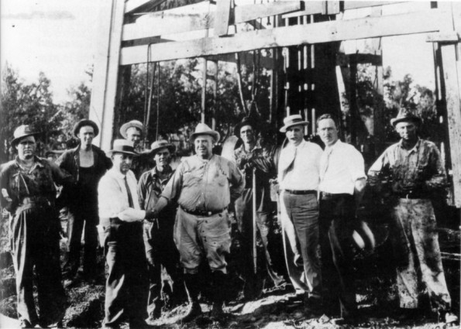
1930: East Texas Field Discovery
East Texas Oilfield Discovered
Dad Joiner sold out to H.L. Hunt
Hunt had made his initial oil fortune in Arkansas with a borrowed $50
He bought out Dad Joiner without spending a penny of his own money
Spawns Hunt Oil, Humble Oil (later acquired by Exxon), and others
East Texas Field Discovery Well: Dad Joiner shakes hands with the portly Doc Lloyd.
H. L. Hunt (third from right), who will buy out Joiner, looks on.
Notes:
Dad had promoted over 100 % of the play!
Hunt negotiated to buy Dad out and did so after confirming the size of the discovery while keeping Dad in the dark.
Hunt found investors who furnished all the money.
Lots of sex to talk about here!
Dad and Doc were notorious ladies’ men
Dad was kept in the dark by booze and prostitutes furnished by Hunt while Hunt awaited news of the confirmation well
HL Hunt was double bigamist.

Slide 22
East Texas Production and the Great Depression Seriously Wounded the 1928 Cartel Agreements
Chaos in the oil industry due to the flood of East Texas Crude
Prices fell to below 5Ȼ/barrel in 1930$ [70Ȼ in 2014$]
Some producers and politicians advocated mechanisms to control production and stabilize prices
Control was difficult because of the number of small producers
Texas Railroad Commission was not authority to regulate production to support prices but it did regulate production to prevent underground waste
Oklahoma Corporation Commission had this power but legality was doubtful
Oil States Advisory Committee, 1931
Conservation by Martial Law
Notes:
—world’s largest field at that time
Called by Alfalfa Bill Murray
Several meetings were held. OK, which had been regulating production, threatened to flood the market if states did not agree to cooperate.
Some state cooperation resulted, but rogue producers exceeded their allowables and took oil across state lines to numerous refineries who assisted in thwarting this cooperative effort
The Advisory Committee proposed an Interstate Commerce just as President Roosevelt was about to take office.
Infighting almost led to federal regulation supported briefly by the API until Secretary Ickes wanted to declare the oil industry a public utility.
Texas Governor sent in the National Guard and the Texas Rangers into the East Texas Field
This effort at martial law was turned back by the courts
By 1933, production flooded the market and prices again plummeted to 4Ȼ/barrel
That prompted the API to support state regulation instead.

Slide 23
The Need for Greater Regulatory Control
“Hot Oil”—oil that was produced in excess of “allowables” mandated by the states was trucked across state borders at night to various refineries
1930s was an era of change at the Federal level—increasing federal regulation across all business sectors under the “New Deal”
National Industrial Recovery Act (NIRA)
Allowed Federal government to set mandatory quota for states and stop hot oil
Held unconstitutional by the Supreme Court in 1935
Notes:
(remember what happened at Spindletop)

Slide 24
NIRA to IOCC
The Connally Hot Oil Act of 1935 reinstated the President’s authority under the prior NIRA "to prohibit the transportation in interstate and foreign commerce of petroleum ... produced or withdrawn from storage in excess of the amount permitted ... by any State law.“
Included procedural safeguards to address some of the constitutional concerns with NIRA
Solution to over-production offered by Congressman E. W. .Marland: Let states form a Compact under the Compact Clause of the United States Constitution
The Interstate Oil Compact Commission, formed in 1935, empowered the member states collectively to set production quotas to “reasonable market demand” using federally-supplied supply and demand data

Slide 25

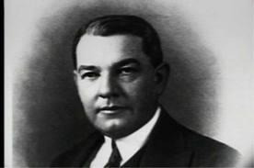
E. W. Marland
Lydie Marland
Notes:
Lydie had an older brother, George.
Both children of Mrs. Marland’s sister and adopted by the Marlands. When Mrs Marland died, Mr. Marland had the adoption of Lydie annulled and married her, so Lydie became her brother George’s stepmother.
For 22 years between 1900 and 1935 Oklahoma ranked first among US producing states and for 9 years it was second.
Thanks to Oklahoma oil discoveries, Marland and his partners controlled 10% of the worlds oil production (the equivalent of Saudi Arabia in 2006)
Lost his company to the JP Morgan banking interests and his fortune as well
Marland became successful politician and elected to Congress.
Congressman Marland was elected Governor of OK in 1934, helping to pave the way for regulation by the states, rather than the federal government.
He called a meeting in December of 1934 in Ponca City. The Governors of Texas and Kansas attended but nothing was accomplished.
Another meeting involving more states was held in Ponca City in January of 1935.
Marland and Texas Governor Allred’s representative quarreled. Texas did not want anything in the Compact that would hint of any price-fixing powers.
Congress threatened to pass federal regulation if the States did not agree.
The impasse between Marland and Allred continued—Allred saying that TX would only support a compact regulating the physical waste of oil, and not any concept of economic waste, supported by Marland.
The final language spoke about regulation to achieve the “maximum ultimate recovery of oil.”
After considerable wrangling in Congress over federal control or in passing a stronger Compact, the IOCC was born on August 27, 1935.
Although price-fixing was prohibited, the provision addressing the prevention of physical waste was broad enough to allow for “market demand prorationing”—to allow for regulating production to a level that would not exceed reasonable market demand or make production of oil not economically viable.
Texas and Oklahoma still go through the formality of assessing reasonable market demand, but then issue an order that allows for flush production.
This approach to regulation emphasized curtailing production to maximum efficient rate of production—that is the conservation of natural reservoir energy to maximize oil recovery.
Ironically, more recent studies of reservoir behavior suggest that rate do production has little effect on ultimate recovery.

Slide 26
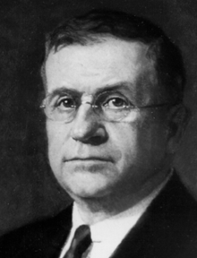
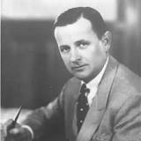
Harold Ickes James Allred

Slide 27
International Government Cartel “Successor” to Red Line, As Is, and IOCC: OPEC founded in Baghdad on September 14, 1960
Founded in response to lowering of posted price by “Jersey” and other majors
Lowered producing government revenues
Seven Sisters produced about 90% of Middle East oil
Founding members: Iran, Iraq, Kuwait, Saudi Arabia & Venezuela
OPEC, in the 1970s, began a production quota system for its member states that is somewhat like market demand prorationing
OPEC did this unabashedly to support oil prices!
Notes:
7 Sisters: Anglo-Persian Oil Company (now BP); Gulf Oil, Standard Oil of California (SoCal), Texaco (now Chevron); Royal Dutch Shell; Standard Oil of New Jersey (Esso) and Standard Oil Company of New York (Socony) (now ExxonMobil)

Slide 28
Where It’s At:
Modern conservation acts, modeled after the New Mexico and Arkansas acts
Purpose: Prevent Waste & Protect Correlative Rights
Through:
Spacing and density regulations
Exception locations
Compulsory pooling
Production restrictions to prevent waste and protect correlative rights (and in some states, limiting production in light of “reasonable market demand”)
Strict drilling, casing, cementing, plugging, and abandonment regulations
A few state conservation agencies (e.g. Michigan) have power to balance oil and gas conservation with other priorities, such as environmental protection
Notes:
David Pierce’s topic is correlative rights—the stepchild of conservation law

Slide 29
The “small-tract” problem
New Mexico and Oklahoma: first states to have comprehensive compulsory pooling statutes in 1935
Michigan (1937) and Arkansas (1939) were not far behind
New Mexico adopted the practice of requiring the consenting parties to carry the non-consenting parties, but subjecting the non-consenting parties’ working interests to a risk premium (similar to JOAs)
Oklahoma adopted the practice of appraising the working interests of non-consenting parties, whereby force-pooled non-consenting parties transferred their working interests in a pooled unit to the consenting parties in return for cash and perhaps an overriding royalty
Texas adopted a practice of granting small-tract exception-location wells “to prevent confiscation,” coupled with a “living allowable” but eventually enacted a limited pooling act
Kansas adopted the practice of granting small-tract exception-location wells, without a disproportionate increase in allowables, but did permit small tracts to voluntarily pool, including non-contiguous acreage, overlying the common reservoir, in order to gain an increased allowable
Notes:
Larry S. Eubanks and Michael J. Mueller, An Economic Analysis of Oklahoma’s Oil and Gas Forced Pooling Law, 26 Nat. Res. J. 469 (1986), finds that the OK practice to be superior from the standpoint of promoting more drilling and development, but it comes at a higher administrative price, compared to the more common risk-premium approach to pooling.
George Snell will talk about the problems associated with Texas practice.

Slide 30
Unitization
Harold Ickes was a strong advocate of unitization in the 1930s
In 1945, Oklahoma passed a compulsory unitization law
Others, including Arkansas, followed in the 1950s and early 1960s
But Texas still has no compulsory unitization act
Curiously, Kansas has a compulsory unitization, but not compulsory pooling
Alaska: only state that has a compulsory unitization act that does not require some minimum % of voluntary agreement to empower its conservation commission to order unitization
Federal regulation authorizes “exploratory unitization” as does the latest IOGCC Model Conservation Act (2004)
Notes:
This has caused some creative Kansas lawyers to try to shoehorn what some states might call pooling into unitization!
Alaska has little in the way of privately owned oil and gas rights. Most lands are federal, state, or Alaskan native lands.
Under federal exploratory unitization, private lands may included in the federal unit—sometimes to the chagrin of private mineral owners who signed leases with unitization clauses in them

Slide 31
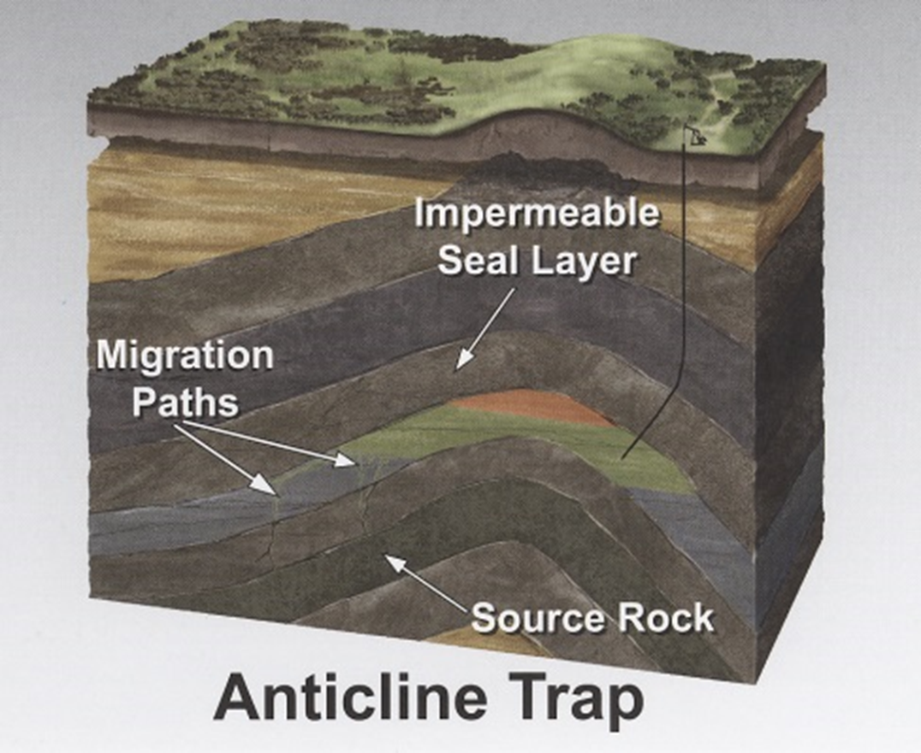
Conservation Law Evolved for “Conventional” Petroleum Development
Porous reservoir rock capable of holding commercial quantities of petroleum
Permeable reservoir rock that allows petroleum to flow through the rock
Petroleum is held in place by rock that traps the oil in place

Slide 32
Where it’s going (or needs to go): “Unconventional” Petroleum
Petroleum still in its source rock—rock that is porous but not very permeable, e.g., shale
Petroleum in a trap that is “tight”—without sufficient permeability to allow flow, e.g., tight sand
Petroleum located in locations that are very expensive to tap, e.g., deep water
Petroleum of a quality that does not permit production through traditional drilling, completion, and production techniques, e.g., oil sands

Slide 33
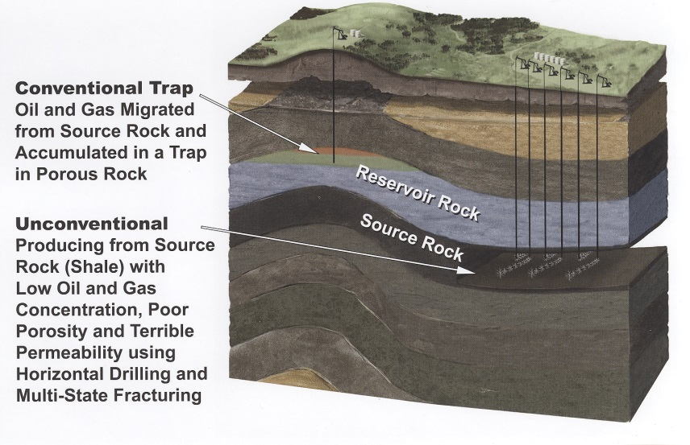
Unconventional Shale

Slide 34
Shale and Tight Reservoirs
In a sense, these reservoirs turn conservation policy on its head
“More wells, more oil”—Rule of Capture and early conservation practice
“Fewer wells, more oil”—Post WWII conservation practice
“More wells, more oil”—shale and tight reservoirs

Slide 35
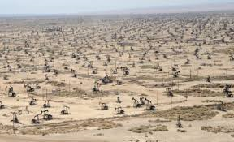
Belridge Oil Field, Kern County CA
Notes:
37.5 foot spacing
Vertical, hydraulically fractured wells 1990s
1100 producing counties in the US: Kern is number 1.

Slide 36
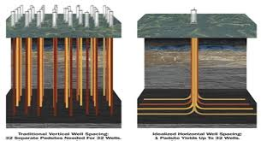

Slide 37
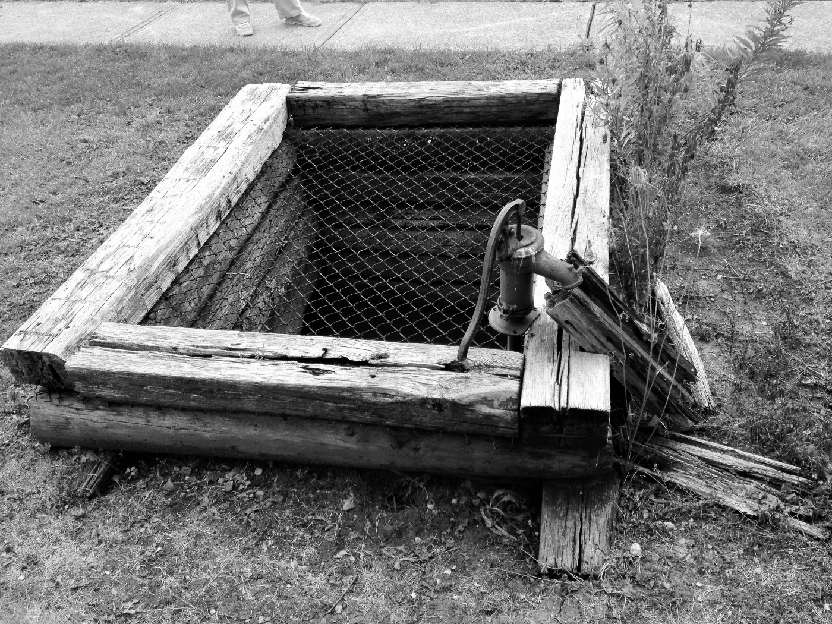
Biggest Conservation Challenge?
Responding to, without stifling, new technology
Most conservation agencies have done a commendable job, although statutory constraints are a problem in a few states

Slide 38
The Big Three Old “New” Technologies
Horizontal Drilling
3D Seismic
Hydraulic Fracturing

Slide 39
Slant to Horizontal Drilling
1920s: several lawsuits alleging that wells had been slant drilled to trespass beneath neighboring property, helped develop technology to measure a wells angle and location
Gyro compasses improved such measurements, developed by Sperry Corp. under contract to Sun Oil company, but spinned off into Halliburton
1934: H. John Eastman pioneered directional drilling to control a well fire in the Conroe oil field in Texas
1970s:
Downhole drilling or mud motors, driven by the hydraulic power of drilling mud circulated down the drill string, allowing the drill bit to continue rotating, while most of the drill pipe remained stationary
Measurement while drilling tools (MWDs) and rotary steel systems (RSS) allow the drill bit to be laterally directed as desired

Slide 40
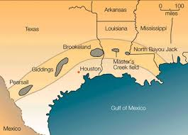
Austin Chalk

Slide 41
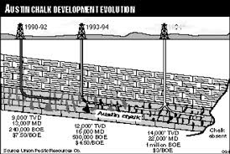
Austin Chalk Horizontal Drilling Using MWD Tools

Slide 42
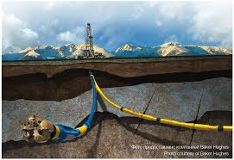

Slide 43
Reflective Seismic Technology
Reginald Fessenden, Canadian inventor, developed initial techniques to infer geology in 1910s, getting a patent in 1917, but never developed it
Ludger Mintrop, a German mine surveyor, used seismic technology to find salt domes in Germany in 1910s and also found oil in Texas and Mexico in early 1920s
John Clarence Karcher in 1910s discovered seismic reflections could be used to detect the location of artillery, and used similar techniques to find oil in Oklahoma in 1921

Slide 44
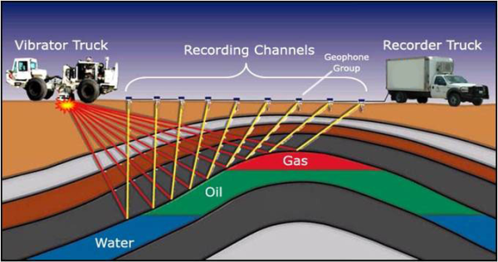
Seismic Surveying

Slide 45
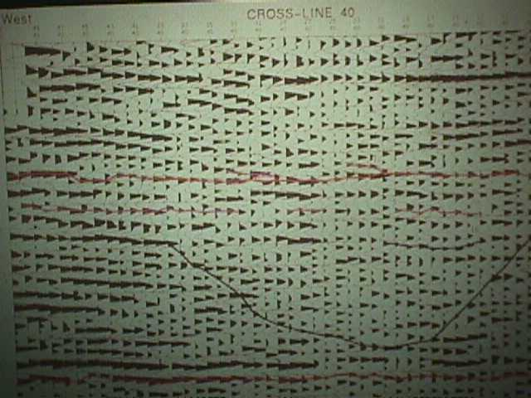
2D Seismic (showing ancient riverbed)
Notes:
Shows a narrow slice across an ancient riverbed

Slide 46



Improvements in Computers led to 3D Seismic
Old Mainframe Computers
Old Desktop Computer
Modern Laptop

Slide 47
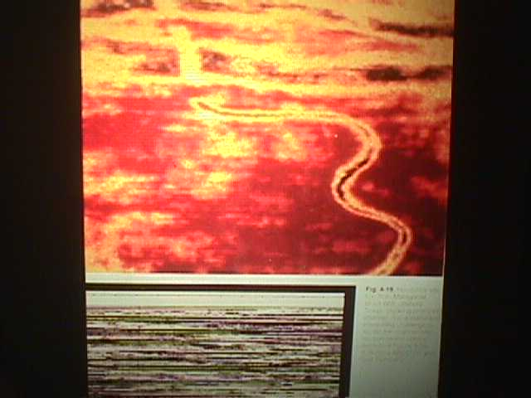
3D Seismic (showing same ancient riverbed)

Slide 48
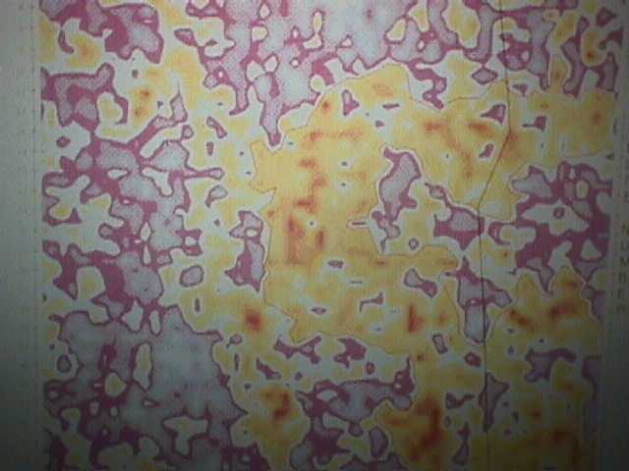
3D (more detail of same riverbed)

Slide 49
Bombing, Shooting, Acidizing, & Fracing Edward A. L. Roberts, 1864 The Grandfather of “fracing”
Roberts arrive in Titusville in 1864, after serving in the Union Army
Inspired by the bombardments at the Battle of Fredericksburg, a major Union defeat, he soon patented a “petroleum torpedo”
The Robert’s torpedo was exploded at the bottom of a wellbore, crudely fracturing the reservoir rock in the immediate vicinity of well bottom to increase the flow of crude oil into the well bore
Notes:
Moonlighters illegally used his methods, leading to a brief “torpedo wars” involving the Pinkerton Detective Agency
By the way, to oil and gas professionals, there is no ‘K’ in fracing, in popular spelling, a “K” is now almost universally included. I am stubborn, so I continue to spell it without a “K”.
Indeed, some commentators believe that the K was intentionally added by fracing opponents to make the word look more like the naughty word for sexual relations—more sex!

Slide 50
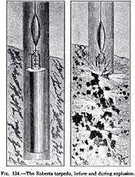
The Roberts Petroleum Torpedo

Slide 51
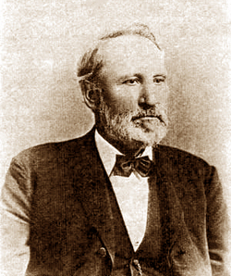
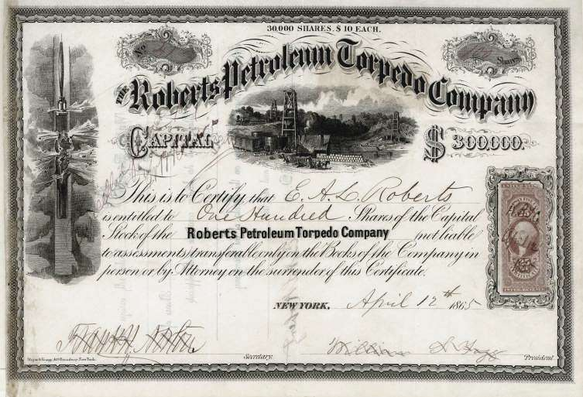
Edward E. L. Roberts & Roberts Torpedo Petroleum Company

Slide 52
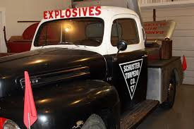
Nitro Truck Eventually, gunpowder gave way to “nitro” and led to well-paid but usually short “well shooter” careers!

Slide 53
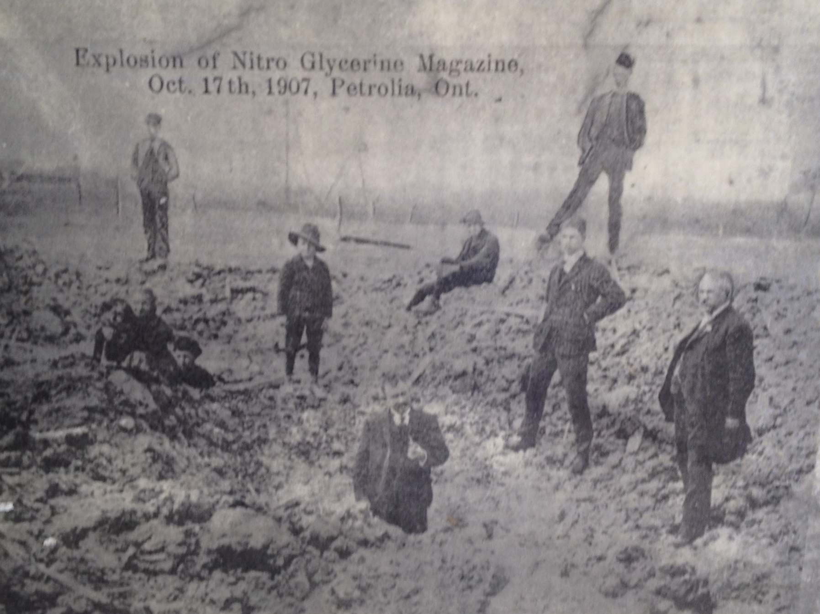
Nitro Explosion Petrolea, Ontario 1907

Slide 54
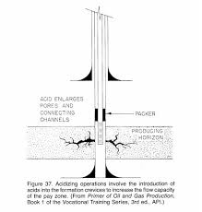
1932
Dow Chemical developed “acidizing” wells to dissolve rock to create flow channels for oil in limestone

Slide 55
1947 Hydraulic Fracturing
Riley Farris and Bob Fast hydraulically fracture wells for Stanolind Oil Company in the Hugoton Field in southwest Kansas
Patent was filed in 1948, with exclusive license issued to Halliburton
More than 100,000 wells were hydraulically fractured by 1955
Notes:
Professor Martin’s topic

Slide 56
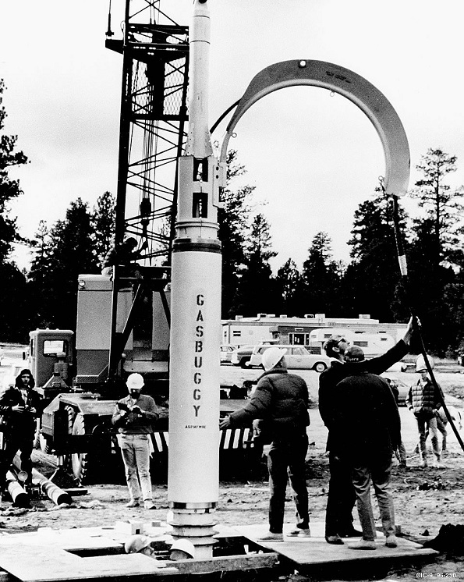
1959 Nuclear Fracturing!
1959: Initial federal research and experiments to test fracing wells with nuclear “bombs,” first suggested by Edward Teller, father of the hydrogen bomb
1967: nuclear bombs set off in gas formation in NM
1969: 43 kiloton bomb set off in gas formation (13 kiloton bomb was dropped on Hiroshima)
Problem: produced gas was radioactive!
1973: tried again with DOE funding
series of 3 bombs
more were scheduled but never detonated—deemed too costly
Notes:
You have all heard of Little Boy and Fat Man, the names of the nuclear bombs dropped on Japan to end the war in 1945.
Meet Gasbuggy. This device was the Gasbuggy nuclear fracing bomb—a mere 29 kiloton bomb.

Slide 57
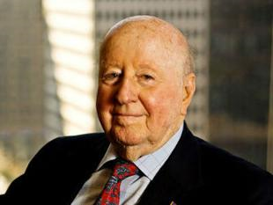
George Mitchell, Mitchell Energy
In 1982, George Mitchell establishes the Barnett Shale Field in TX, and began experimenting with different hydraulic fracturing techniques
1981: Mitchell drilled and hydraulically fractured the C. W. Slay#1 shale well—a well drilled into the source rock or “kitchen”
This vertical well was not commercial
1998: Mitchell “mistakenly” hydraulically fractures the S. H. Griffin #4 well without using “frac gel”
Well succeeds where many others had failed
Now, now more than 100,000 such wells drilled and fraced in shales
Notes:
He was concerned that he might be unable to meet his commitments to deliver natural gas to the City gate in Chicago
There is not K in frac!

Slide 58
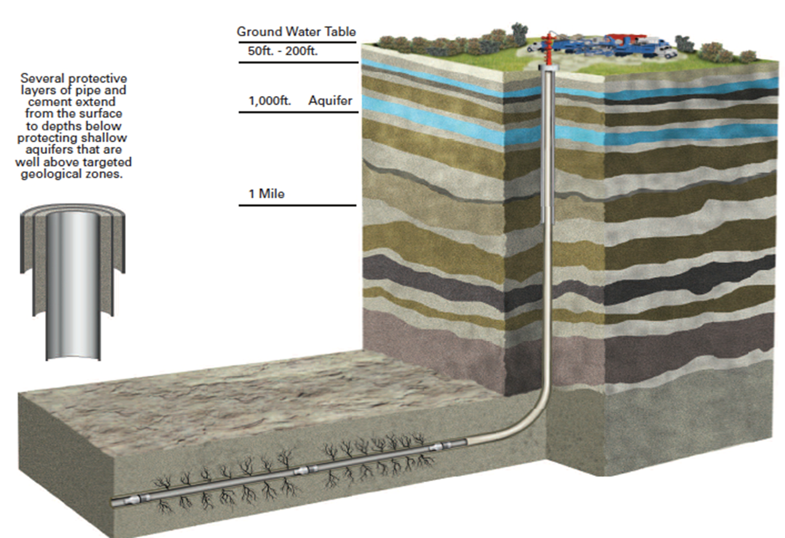
Hydraulic Fracturing

Slide 59
A Fourth Technology: offshore drilling
Notes:
Promoted by an Mitchell Energy field engineer, Nick Steinsberger
Inspired by the THUMS project
Texaco, Humble, Union, Mobil & Shell developed the Long Beach Field in CA
Pumped in water to replace oil to prevent subsidence
Union Pacific has used water fracs in sandstone, not shale.
Beach Sand: 5 darcies
East Texas oil-bearing sandstones: 0.0001 darcy, 50,000 times less permeable than beach sands
Barnett Shale is 1,000 less permeable than the East Texas sandstones. 100 nanodarcies, 0.0000001
FIND INFO ON 3D AND MICROSEISMIC

Slide 60

Offshore Drilling from Piers
Near Santa Barbara California, begins in 1896

Slide 61

Kerr McGee drilled first true “offshore” well in 1947

Slide 62

Offshore Drilling Innovations

Slide 63

Deepwater Horizon
Notes:
A drilling vessel that should be remembered for setting modern deepwater drilling records, will instead be synonymous with disaster, in part due to regulatory failure.

Slide 64
Other Conservation Challenges

Slide 65

Seismicity
Some small earthquakes that have caused some damage may have been induced by disposal wells
St. Gregory’s Abbey, Shawnee, OK
Damaged by an earthquake in 2011
Notes:
Not limited to salt water disposal, but these wells are large in number and vital to the oil and gas industry
If disposal is a culprit, the problem is fixable, but at the cost of drilling new disposal wells in less “faulty” areas

Slide 66
Water and Hydraulic Fracturing “Whiskey’s for drinkin’ and water is for fightin’”—Mark Twain
Wood Mackenzie
Agriculture uses 2/3 of global freshwater supplies
Energy is second largest user at 15% for all energy uses
UN study predicts a 40% shortfall in global freshwater supplies by 2030
WoodMac says that water shortages could have a negative impact on shale plays in the US and on Middle East production growth
BUT WoodMac is optimistic that new technologies will solve these problems provided regulatory uncertainty does not fetter technological advancement

Slide 67
Unitization of Shales
Another Wood Mackenzie study, announced September 23, 2014,
Preliminary findings: shale production could increase an additional 25% using EOR (Enhanced Oil Recovery) techniques currently being tested in the Eagle Ford
Yield could be additional 350,000 – 450,000 b/d
But WoodMac warns that US will need to allow oil exports to support the additional capital costs of EOR—projected at $5 billion for each additional 400,000 b/d of production over 5 years
Without relaxation of the oil export ban, US oil prices could fall about $30/barrel under comparable international benchmark crudes
Notes:
Bruce Kramer’s topic
EOG is a leader in these Eagle Ford EOR tests
That $30 decline would put shale oil and oil sands at risk of being uneconomic
You must keep drilling shale wells to maintain production

Slide 68
Pre-emption, Peaceful Co-Existence, or Friction: Conservation Law v. Local Law
Serious problems in Colorado, Pennsylvania, New York, and Ohio
Yes, even Texas!

Slide 69
Well Locations in Pooled Units
Oklahoma case law has long allowed the operator of a pooled unit to locate the well anywhere on the unit
Including on acreage that was forced pooled in part because the mineral owner also owned the surface and did not want any oil operations conducted on the surface
Very controversial in some other states, especially those without recent oil and gas operations and where small-tract acreages are the norm
Notes:
Insert the cartoon from casebook
Stockraising and Homestead Act

Slide 70

Why Petroleum Conservation?

Slide 71

Why Petroleum Conservation?

Slide 72
Why State (as opposed to federal)
Conservation Regulation?
Just one example:

Slide 73

Notes:
The Standard Oil Trust and other shippers of crude oil in the old days shipped oil in barrels.
It was handy to ship barrels of whiskey into oil field areas and ship barrels of oil out.
This practice gave us the “barrel of oil,” now standardized to 42 gallons.
But shipping oil by barrels gradually came to an end after Marcus Samuel, a founding father of Shell Oil Co., began shipping oil in ocean going vessels that came to be called oil tankers.

Slide 74



Slide 75


In the US, Long-Distance Transport of Oil Is Largely Federally Regulated
Notes:
In some ways, no where very fast.
Shipping oil in tanks is not the ideal answer

Slide 76

Notes:
December 1913
Safety hazard but also a form of surface waste
Fires have caused the loss of a great deal of oil

Slide 77


Slide 78

Feds have still not approved the Keystone XL Pipeline that should have been approved in 5 years ago
Notes:
The failure to approve the Keystone pipeline has discouraged additional pipelines from being constructed, so we are continuing to ship large quantities of oil by rail, which is not as safe, not as environmentally friendly, is more expensive, and causes competition with other industries, especially coal and agricultural products. The chief benefit of rail tankerage seems to be Warren Buffet, a friend of President Obama, whose company Berkshire Hathaway owns the Burlington Northern Santa Fe RR, a major shipper of Bakken crude oil.

