Slide 1
RULES DONE RIGHT HOW ARKANSAS BROUGHT ITS OIL AND GAS LAW INTO A HORIZONTAL WORLD

Slide 2
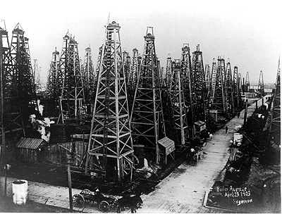
BEFORE REGULATION, YOU COULD CAPTURE, OR BE CAPTURED FROM
WHAT THIS PICTURE NEEDS IS SOME GOVERNMENT INTERVENTION

Slide 3
HOW DID ARKANSAS BRING ITS OIL AND GAS LAW INTO A HORIZONTAL WORLD?
Flexible modern enabling statutes
Flexible modern rules

Slide 4
Act No. 105 of 1939
AN ACT to Prevent Waste, Foster, Encourage and Provide Conservation of Crude Oil and Natural Gas, and Products Thereof and Protect the Vested, Co-Equal or Correlative Rights of Owners of Crude Oil or Natural Gas . . .

Slide 5
Act No. 105 of 1939
Created the conservation agency, the AOGC
Mandated formation of drilling units in which all owners are given correlative rights:
(2) As used in this subchapter, unless the context otherwise requires, “drilling unit” means the maximum area which may be efficiently and economically drained by one (1) well, and the unit shall constitute a developed unit as long as a well is located thereon which is capable of producing oil or gas in paying quantities.

Slide 6
Act No. 105 of 1939
The 1939 act permitted integration (compulsory pooling) of uncommitted interests, but did not provide for a penalty amount to be recovered by participants from non-consenting interests

Slide 7
Act No. 536 of 1963
This amendment to the Conservation Act rewrote the integration provision to mandate a risk-factor penalty on carried non-consenting interests and to authorize a “permanent transfer” of non-consenting parties’ interests (i.e. a forced oil and gas lease)

Slide 8
Act No. 881 of 1985
Permitted the formation and integration of “Exploratory Drilling Units” (units for wildcat wells)
Requires that a minimum of 50% of unit’s working interest support the formation of an Exploratory Unit

Slide 9
Act No. 964 of 2003 Redefined “Unit” for purposes of the Conservation Act
Original Conservation Act
Amended Conservation Act
(2) As used in this subchapter, unless the context otherwise requires, “drilling unit” means the maximum area which may be efficiently and economically drained by one (1) well…
(2)(A) As used in this subchapter, "drilling unit" means a single governmental section or the equivalent unless a larger or smaller area is requested by an owner, as defined in § 15-72-102, within the drilling unit to be established and a larger or smaller area is established by order of the commission…

Slide 10
Act No. 964 of 2003
Expressly authorized multiple unit wells from the beginning of development:
(2)(B) The commission shall have the continuing authority to:
(i) Designate the number of wells that may be drilled and produced within a drilling unit; and
(ii) Regulate the spacing among multiple wells drilled and produced within a drilling unit.

Slide 11
WELCOME TO THE FAYETTEVILLE SHALE PLAY!!!
The oil and gas business learned a new and wonderful word —“unconventional.”
The critical characteristics of an unconventional reservoir are high organic content, conducive to the formation of oil and/or gas, but very low permeability.
Scientists have long theorized that immense reserves of oil and gas were locked within unconventional rocks, but lacked the ability to produce those reserves with conventional vertical-well technology, making their exploitation commercially impractical.
Science then came to the rescue. Around the start of this century, the drilling industry perfected two processes, horizontal drilling and multiple stage hydraulic fracturing (fracking).

Slide 12
Rules Must Adapt to Accommodate New Science
Unconventional Resource Development Brings New Regulatory Challenges

Slide 13
Unconventional Resource Development Brings New Regulatory Challenges
Prevention of waste:
Wells are long skinny horizontal things, hard to fit into boxes; moreover, polar orientation is not always best
Lack of formation permeability mandates wells to be located on close spacing
These closely spaced wells work better if they work in coordination, rather than competition with one another
Scientists continue to learn, and improve, on-the-fly, thus challenging even the most recent assumptions
Protection of correlative rights:
Science or no science, regulation must still protect every owner’s fair share

Slide 14
Examples of Arkansas’s Modern Regulation
Detailed integration orders¹
Regulation in advance of development: AOGC General Rule B-43
Modern, environmentally-based regulation of processes such as fracking and underground disposal¹
¹These apply to all wells, conventional and unconventional.

Slide 15
Detailed Integration Orders
Unleased mineral owners who are “deemed leased” are bound by the terms of an express lease form, adopted by AOGC, whether they execute it or not
The “deemed” lease applies to subsequent unit wells, also
Owners who participate or are non-consent are bound by the terms of a JOA, adopted by AOGC, whether they execute it or not
This JOA applies to subsequent unit wells, also

Slide 16
GENERAL RULE B-43
Abandons well-by-well “Field Rule” approach in favor of regulating the entire play, all at once
Covers every known or reasonably imagined occurrence of an unconventional reservoir in the state.
Covers almost every aspect of the regulation authorized by the Conservation Act
Not Static; Continues to change and improve as the industry changes and improve

Slide 17
GENERAL RULE B-43
Pre-forms 640 acre units across multiple counties
Allows 16 wells, per reservoir, per unit¹
Provides for reasonably close well spacing (560’) and reasonably accommodates even closer spacing via easily obtained location exceptions
Makes the outcome of disputes before the agency predictable
Permits shared cross-unit wells
¹More to come about the “16-well problem”

Slide 18
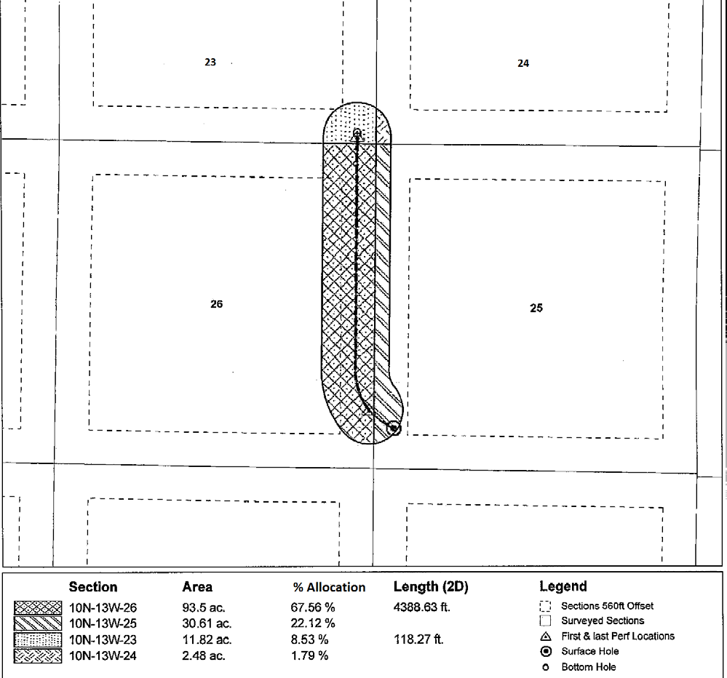
SHARED CROSS-UNIT WELLS THINKING OUTSIDE OF THE BOX

Slide 19
THE BAND-AIDE IS BEST
Band-Aide

Slide 20
The cross-unit well is here to stay. According to the A.O.G.C. records, more than 85% of all wells permitted to be drilled in the Fayetteville Shale Play today are cross-unit wells. The next picture shows what the result looks like.

Slide 21
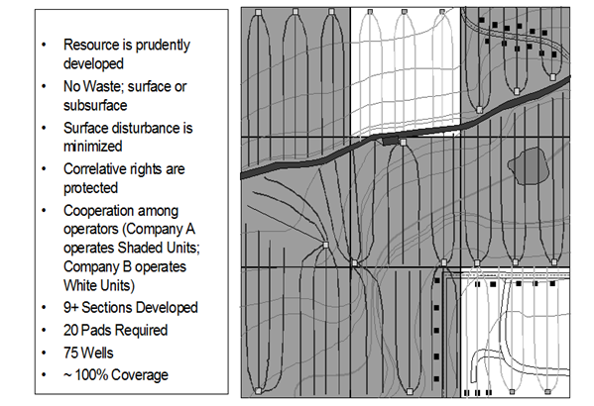
END OF THE GAME PICTURE

Slide 22
THE SIXTEEN WELL PROBLEM NOTHING IS PERFECT
Because of an unintended incongruity between rules, each segment of a cross-unit well is counted as a separate well for purposes of the otherwise generous sixteen-well limit. In other words, a single well could be counted twice, thrice or more times.

Slide 23
CAN YOU FIND THE TWO WELLS IN THIS PICTURE?

Slide 24
CAN YOU FIND THE TWO WELLS IN THIS PICTURE?
Well No. 1

Slide 25
CAN YOU FIND THE TWO WELLS IN THIS PICTURE?
Well No. 2
Well No. 1

Slide 26
CAN YOU FIND THE TWO WELLS IN THIS PICTURE?
Well No. 2
Well No. 1
Not a Well

Slide 27
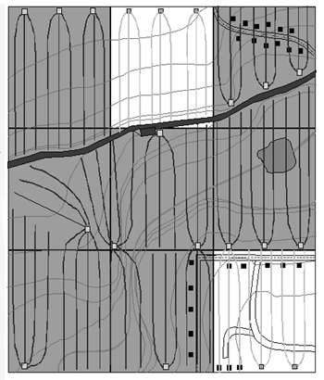
FOCUS ON THESE TWO UNITS
18 SEGMENTS,
COUNTED AS 18
WELLS
21 SEGMENTS,
COUNTED AS 21
WELLS

Slide 28
THE SIXTEEN WELL PROBLEM—NOTHING IS PERFECT
The result of this weird confluence of AOGC rules appears arbitrary. It punishes units which are developed by multiple short segments of cross-unit wells, for no good reason.
Neither does it appear to protect anyone’s correlative rights. Even if it is accepted that protection of the surface is within the power of the A.O.G.C., the rule has nothing to do with surface use. A well is counted as one of the sixteen, whether its surface location is in the unit or not.
The A.O.G.C. has declined to consider changing or abolishing this rule, regardless of its apparent lack of valid purpose.
Fortunately, however, it has granted exceptions to the rule when it has been shown that a significant portion of a unit would otherwise go undeveloped.

Slide 29
Modern regulation of environmentally sensitive processes
General Rule B-19 regulates completions utilizing hydraulic fracture treatments
General Rules H-1, H-2 and H-3 regulate SWD wells

Slide 30
A FINAL POINT
Regulation must have the ability to adapt. Otherwise, we risk allowing our rules to hamper technology
Arkansas has become a leader in the transition of its statutes and rules to accommodate the industry’s shift to unconventional reservoir development
Inevitably, the future will bring more technological advances. The challenge will be to continue to adapt regulation to exploit, rather than hamper, those future developments, whatever they turn out to be, while still preventing waste and protecting correlative rights

