Slide 1


STATUTORY UNITIZATION: AN UNDER-UTILIZED CONSERVATION TOOL
Arkansas Law Review Symposium: 75th Anniversary of the Arkansas Conservation Act
Bruce M. Kramer
Of Counsel

Slide 2
INTRODUCTION
Unitization/unit operations –
“. . . the consolidation of mineral or leasehold interests covering all or a part of a common source of supply.”
1 Patrick H. Martin & Bruce M. Kramer, The Law of Pooling and Unitization 1-3 (3d ed. 2014)

Slide 3
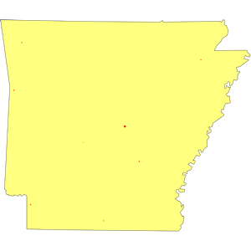
INTRODUCTION
Ark. Code 15-72-308 to 314 –
Statutory unitization
Ark. Code 15-72-315 to 322 – Statutory unitization – Salt water disposal units
Ark. Code 15-72-323 to 234 – General provisions

Slide 4

INTRODUCTION
Benefits of unitization
Prevents waste
Prevents overdrilling
Prevents wasteful dissipation of natural reservoir pressure
Allows for secondary and tertiary recovery projects
Efficiencies of scale
Surface use minimized

Slide 5
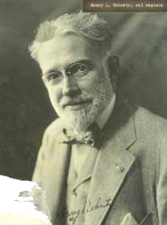
INTRODUCTION
H.L. Doherty – Led a crusade for a federal unitization statute in the 1920’s
Persuaded President Coolidge to create the Federal Oil Conservation Board
Disbanded by President Roosevelt
R.E. Hardwicke, Antitrust Laws, et al. v. Unit Operation of Oil or Gas Pools (1961)

Slide 6

STATE UNITIZATION STATUTES
1929 ABA Section of Mineral Law
Adopted policy statement in favor of statutory unitization
Many of the principles contained in statement served as foundation for later state regulatory actions
54 Rep. A.B.A. 739-40 (1929)
Maurice Merrill, Stabilization of the Oil Industry and Due Process of Law, 3 S.Cal.L.Rev. 396 (1930)

Slide 7
STATE UNITIZATION STATUTES
Voluntary unitization statutes
California (1929 Cal. Stat. Ch. 534, p. 293)
New Mexico (1929 N.M. Laws p. 132)
Failure of industry efforts to voluntarily unitize
Two voluntary units in Arkansas by 1930 (Amer. Inst. of Min. & Metallurgical Eng’rs (1930)
North Dome Kettleman Hills Field – CA (federal lands)

Slide 8
STATE UNITIZATION STATUTES
Louisiana – Limited purpose statutory unitization provision enacted in 1940
(Act 157 of 1940)
Cycling Operations/Secondary Recovery
Other states followed: Arizona; Florida, Georgia, Illinois, Indiana

Slide 9
STATE UNITIZATION STATUTES
Oklahoma Unitization Statute –
Enacted in 1945 (1945 Okla. Sess. Laws 162-170) – Introduced in 1941
Unitize all or a portion of a common source of supply
Not limited to gas cycling or recycling
50% consent requirement
Veto provision – 15% - later repealed

Slide 10
STATE UNITIZATION STATUTES
Palmer Oil Corp. v. Phillips Petroleum Co., 1951 OK 78, app. dism’d, 343 U.S. 390 (1952)
Upholds constitutionality of statutory unitization
Both facially and as applied to order for West Cement Medrano Unit
Delegation of legislative power
Due process/regulatory taking
5-4 decision

Slide 11
STATE UNITIZATION STATUTES
Arkansas
Dobson v. Arkansas Oil & Gas Commission, 235 S.W.2d 33 (1950) – AOGCC lacks authority to issue unitization order
Arkansas adopts statutory unitization in 1951 – 1951 Ark. Acts sect. 134

Slide 12
STATE UNITIZATION STATUTES
Most oil and gas producing states have a statutory unitization provision – Kramer & Martin, sect. 18.01
Pennsylvania and Texas are the major exceptions
William F. Carr, Compulsory Fieldwide Unitization, 49 RMMLF Ann. Inst. 733 (2003) (compares language and requirements)

Slide 13
STATE UNITIZATION STATUTES
Procedures
Similar to procedures for statutory pooling/integration in most cases
Applications – Detailed laundry list of requirements
Notice – General conservation statute provisions augmented by agency regulations
Hearing – Agency regulations

Slide 14
STATE UNITIZATION STATUTES
Orders
General findings
Laundry list approach/tied into application requirements
Consent
Most states require minimum consent prior to issuance of order
Application stage – Ark. Code 15-72-305
Order stage

Slide 15
STATE UNITIZATION STATUTES
Working interest owners, royalty interest
owners, unleased mineral interest owners
Issues in consent requirement
Fractional owners
Surface acreage
Allocation formula

Slide 16
STATE UNITIZATION STATUTES
Participation/Allocation Formula
Proposed by unit operator and contained in Unit Agreement or Unit Operating Agreement
Single factor formula
Common for pooled units (surface acreage)
Uncommon for unitization
Multi-factor formula
Gilmore v. Oil & Gas Conservation Commission, 642 P.2d 773 (Wyo. 1982)

Slide 17
STATE UNITIZATION STATUTES
Participation/Allocation Formula
Post-execution adjustments
Exploratory versus enhanced recovery units
Horizontal wells
Drainage patterns

Slide 18
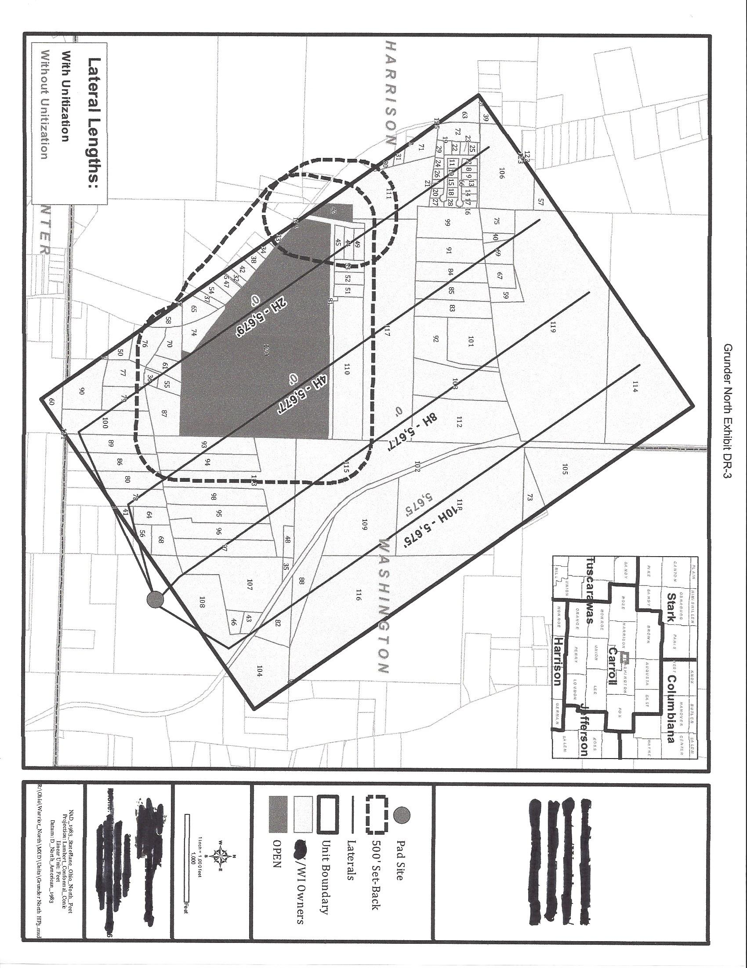
HYPOTHETICAL

Slide 19
Contact Information
BRUCE M. KRAMER
McGinnis Lochridge
711 Louisiana St., Ste 1600
Houston, TX 787
(713) 615-8508 Direct
(713) 615-8500 Main
(512) 615-8585 FAX
bkramer@mcginnislaw.com
Website: www.mcginnislaw.com

