Slide 1

Comparison of State Oil and Gas Regulation vs Federal Environmental Regulation in Response to Important Historical Developments of Arkansas’ Oil and Gas Resources
STATE!
John F Peiserich
PPGMR Law, PLLC
Arkansas Law Review Symposium:
75th Anniversary of the Arkansas Conservation Act
October 17, 2014

Slide 2

Historical Developments
Initial Discoveries
Regulatory Bodies
  Arkansas Oil & Gas Commission
  Arkansas Pollution Control & Ecology Commission
Key Regulations
Modern Discovery Impacts

Slide 3
Facts and Figures
approximately 48,000 wells since 1925
4,100 wells by approximately100 operator in western Arkansas
5,000+ wells by 3 operators in Fayetteville Shale
7,200 wells by over 100 operators in south Arkansas
8th in NatGas production and 18th in oil production

Slide 4
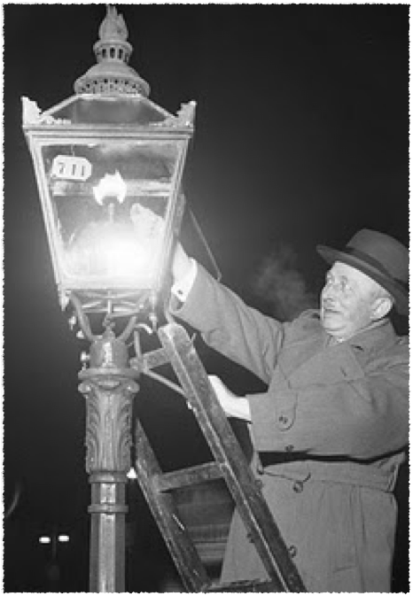
Natural Gas Discovery
1887
Scott County
south of Fort Smith
it was an attempt to develop a commercial water well
Notes:
In 1821, William Hart dug the first successful natural gas well in the U.S. in Fredonia, New York. Eventually, the Fredonia Gas Light Company was formed, becoming the first American natural gas distribution company.
The second recorded gas well was drilled two years later (also in Scott County) by an oil driller, Harry Kelly, to a depth of 1,600 feet. This was recognized as the first recorded effort to find oil in Arkansas, though “only gas was present.” No other efforts to find oil or gas were reported until 1901–1902, when the Mansfield Pool was developed by Choctaw Oil and Gas Company.
While no oil was found, this effort did provide large amounts of gas, with some wells producing as much as 5 million cubic feet of gas per day. This 3,000-acre field was sufficient to provide commercial gas services to the town of Mansfield (Sebastian County). By 1907, Fort Smith (Sebastian County) and Van Buren (Crawford County) had commercial service, and an industry was developing. Other finds included Polk, Conway, and even Pulaski counties. However, only the town of Plumerville (Conway County) made commercial application. Street lamps there used natural gas for a period of time prior to 1909.
During most of the 19th century, natural gas was used almost exclusively as a source of light. Without a pipeline infrastructure, it was difficult to transport the gas very far, or into homes to be used for heating or cooking. Most of the natural gas produced in this era was manufactured from coal, rather than coming from a well. Near the end of the 19th century, with the advent of electricity, natural gas lights were converted to electric lights. This led producers of natural gas to look for new uses for their product.
WHO KNOWS WHO DEVELOPED THE FIRST COMMERCIAL USE FOR NATURAL GAS? ROBERT BUNSEN - THE “BUNSEN BURNER” SHOWED HOW GAS COULD BE USED FOR COOKING AND HEATING.

Slide 5
Natural Gas Fields
Arkansas produced approximately 1 TCF annually which is 4.5% of the national total
10,000 natural gas wells statewide
Arkoma Basin (historically the largest)
Southern Arkansas
Fayetteville Shale
  now more than 90% of state production
  5,000 wells
Coalbed Methane

Slide 6
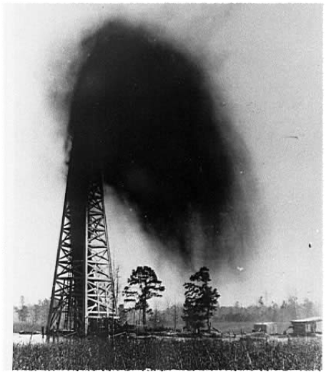
OIL!
BUSEY NO. 1
JANUARY 10, 1921
1 mile SW of El Dorado
A classic “gusher” that sprayed oil up to 1 mile away
Notes:
Samuel Thompson Busey was a 1920s oil speculator and promoter of the Arkansas oil industry. While originally trained as a physician, he later became a geologist and completed the famed “Discovery Well,” or Busey No. 1 Well, outside El Dorado (Union County) in 1921. Busey’s efforts helped usher in the south Arkansas oil boom of the 1920s.
By this time, the Mitchell-Bonham Drilling Company had acquired drilling rights on the eighty-acre David R. Armstrong farm southwest of El Dorado. It had drilled a well to a depth of about 1,700 feet, but operations were suspended for financial difficulties. On November 15, 1920, Busey arranged with local investors and took fifty-one percent ownership of the company, along with rights to the well, all tools, and the eighty-acre tract that was being drilled. Drilling operations were resumed, but by early January 1921, Busey had to sell off shares of the company and rights to some of the land to meet expenses. On January 10, 1921, at 4:30 p.m., the Busey No. 1 Well, as it was then named, was drilled to a depth of 2,233 feet and struck oil. Oil erupted to the surface, spraying the area with oil for more than a mile around. Busey’s rich Discovery Well produced an astounding fifteen million to thirty-five million cubic feet of natural gas and between 3,000 and 10,000 barrels of oil and water daily. This led to the oil boom that began petroleum development in Arkansas.
Oil production increased exponentially in a matter of months. In March 1921, Arkansas produced 38,000 barrels of oil to sell on the open market, which increased to 325,000 barrels by April, to 578,000 barrels by May, and to 908,000 barrels by June. By 1922, 900 wells were in operation in the state.
Sidney (Sid) Albert Umsted, known as the “Father of the Smackover Oil Field,” drilled the first well in the Smackover (Union County) area, introducing Arkansas’ largest oil discovery. In 1925, the Smackover field produced over 77 million barrels of oil and was the largest oil field in the nation at that time.
Although Arkansas production ranked far behind such oil-producing states as Texas, Oklahoma, California, and Louisiana, El Dorado immediately became the epicenter of the oil boom. It changed from an isolated agricultural city of approximately 4,000 residents to the oil capital of Arkansas. Twenty-two trains each day ran in and out of El Dorado to Little Rock and Shreveport, Louisiana, and regular air service from Shreveport transported workers and investors.
By 1923, El Dorado boasted fifty-nine oil companies, thirteen oil operators, and twenty-two oil production companies. The city was flooded with so many people that no bed space was available for them, leading to the building of neighborhoods of tents and hastily constructed shacks throughout the city. The city’s population reached a high of 30,000 in 1925 before dropping as the boom played out in the late 1920s.
In 1922, the Smackover Pool was discovered near the Union-Ouachita County Line outside the farming town of Smackover (Union County). Smackover, like El Dorado, also swelled with oil workers and fortune seekers. Its population surged to 25,000 within a few months in 1922 from a mere 131. The oil-producing area of the Smackover Pool covered more than 25,000 acres and, by 1925, had become the largest-producing oil site in the world. The Smackover Pool would eventually produce 583 million barrels of oil by 2001.
At the peak of the boom in 1925, some 3,483 wells produced seventy-three million barrels of oil in one year. So much oil was produced that trains could not transport all the oil out of the area to refineries. In 1926, Smackover producers began storing oil in open earthen pits, causing much of this oil to be lost due to contamination from rain and spills. It also contaminated the groundwater itself. Many pools proved to have relatively limited supplies. In the early 1920s, wells often ran at full capacity, which let many of the wells run dry within five years of the boom. The Arkansas Conservation Commission issued recommendations to producers to prevent such waste, and, with several larger oil companies, filed lawsuits in the late 1920s to extend the life and productive efficiency of the oil fields.
The state established the Arkansas Oil and Gas Commission in 1939 to regulate the state’s oil and natural gas industry. Originally a seven-member commission, the state legislature expanded it to nine members in 1985.
The boom came to an end by the late 1920s, but the industry nevertheless continues its presence in the region. Oil production dropped dramatically, from a little over fifty-eight million barrels in 1926 to twelve million barrels by 1932. An additional twelve major pools were discovered between 1936 and 1947. These included the Shuler and Magnolia pools, discovered in Union County in 1937 and Columbia County in 1938, respectively. These fields have each produced more than 110 million barrels of oil. From the late 1930s into the late 1960s, the oil industry enjoyed a resurgence in south Arkansas, though paling in comparison to the boom years of the early 1920s. Production between 1939 and 1967 stayed above twenty million barrels of oil each year, rising slightly during World War II as levels hit thirty million barrels annually for 1944 and 1945, with levels staying near that mark until 1961. One last major pool, Chalybeat Springs, was discovered in 1971.

Slide 7
Famous Oil Fields
El Dorado Field
  First field established 1921
Smackover Field
  Discovered 1922
  Approximately 600,000,000 bbls produced
Magnolia Field
  Discovered 1938
  Approximately 175,000,000 bbls produced

Slide 8
Early O&G Regulation
Who can tell me when the first conservation act was passed?
Act 166, Session Acts of 1917 - “An Act to Conserve the Natural Gas Resources of the State of Arkansas and to Appoint a Gas Inspector and for Other Purposes.”
Resulted from inexperienced drilling practices whereby water reached the gas sands.
It described drilling and casing, shut-in to prevent waste, P&A methods, well logs, and imposed a limitation of flow rate (20% of AOF).

Slide 9
Round 2 - Act 144 of 1921
Inspector determines AOF
AOF ok if pressure is less than 100 lbs
All production has to be metered
Requires protecting the encountered formations using mud-based fluids (whether productive or not)

Slide 10
Early “Enforcement”
When would you guess Arkansas first took some type of enforcement action for waste?
1922 - Arkansas filed criminal actions against several producers in south Arkansas charging them with violation of the statutes in permitting gas to escape “unnecessarily”.
The defendants argued that they couldn’t produce the oil without the loss of gas and that the statutes only applied to gas wells.
Ultimately, the charges were dismissed.

Slide 11
What do you do when this happens?
The Railroad Commission takes over!
1923 - General Assembly steps in to address waste in south Arkansas.
Defines and prohibits waste - above and below ground
Commission expressly given authority to create regulations

Slide 12
More Early Acts
1925 - creation of Commissioner of Conservation & Inspection (no benefits from this one)
1927 - created an Honorary Board of Conservation - better - they had the power to create rules/regs
1933 - Act 234 - Arkansas Board of Conservation - requires board members to be experienced; re-enacts the good stuff that was lost in 1925; AG can issue injunction for violations; permits required before drilling; introduces penalties for violations

Slide 13
The First “Conservation”
Jan. 1, 1938 - Miller County - allowables fixed for production of oil from Rodessa
1938 - Jones sand in Shuler field in Union County - first idea that uniform well spacing and uniformity of withdrawal was necessary
Gas-Oil Ratio introduced at about the same time

Slide 14
Why Regulate?
In recognition of past, present, and imminent evils occurring in the production and use of oil and gas as a result of waste in the production and use thereof in the absence of coequal or correlative rights of owners of crude oil or natural gas in a common source of supply to produce and use the crude oil or natural gas, this law is enacted for the protection of public and private interests against such evils by prohibiting waste and compelling ratable production.
- Ark. Code Ann. § 15-72-101 - Declaration of policy. (AOGC)

Slide 15
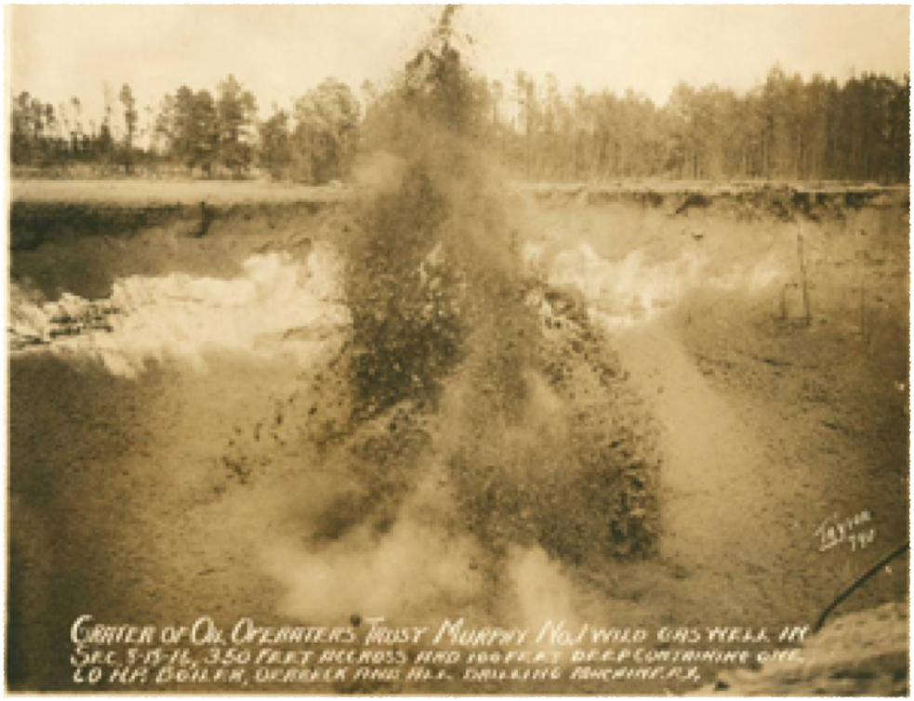
Notes:
In May 1922 the scene of action in Union County's oil boom shifted to the area around the peaceful little farm and timber village of Norphlet, eight miles due north of El Dorado, where wildcatting had begun. About eight o'clock in the evening of May 14th, the discovery well in the famous Smackover Field, Murphy No. 1, owned by the Oil Operators Trust, came roaring in (in Section 8, Township 16 South, Range 15 West) with an estimated sixty- five to seventy-five million cubic feet of gas a day. The tremendous force of the gas demolished the derrick, blew out the string of drill stem, and sent the drilling crew scampering for their lives. Balls of hard-packed red sand went sailing through the air, and the roar of escaping gas was so deafening, that drilling crews a quarter mile away had to plug their ears. Murphy No. 1's crew worked frantically to save the steam boiler and drilling rig, but were unsuccessful as the ground caved in and swallowed it up. The gigantic blowout was a fitting opening passage for the story of Smackover Field, which "gave to petroleum one of the most dramatic chapters in the history of the industry."
By the morning, of the 15th craters had begun appearing around the well, and by nightfall of that day half a dozen of them were afire from the friction caused by the rapidly escaping gas. Then, early on the morning of May 16th, the "giant gasser" itself caught on fire and flames "shot more than 300 feet into the air." "Black smoke and slate- colored dust" boiled even higher. The great crater at the center ate into the many small craters about it, consumed them, and grew even larger, forming "a miniature Grand Canyon." Finally, after burning for seven hours, the fire extinguished itself when the mighty hole in the earth began to "spurt gas only at intervals."
But even after the flames went out, the huge crater continued to erupt, spouting immense quantities of gas and sand high above its rim. The boiler from the drilling rig, which had toppled into the monstrous hole, could be seen at the bottom during these periodic gas eruptions spinning like a top."
Estimates of the size of the crater formed by the ill-fated Murphy No. I vary, but it was at least 450 feet across and fifty to seventy-five feet deep. A man who flew over it , while it was still active, trying to gauge its size, reported that sand blown from the crater hit him in the face at 7,000 feet. This sand was in reality "pulverized shale," and it settled to earth as far away as ten miles in every direction. "Vesuvius," as the crater was sometimes called, caught fire again several times, but always burned itself out. It was said to have been one of the largest gas wells ever drilled in the world.
On June 21, 1922, the Oil Operators Trust completed another well on the Murphy lease, a quarter of a mile south of No. 1, which came in throwing sand and fresh water 100 feet over the derrick. One reason for drilling No. 2, was the hope it might weaken the first well, but in that respect it was unsuccessful. On June 28, No. 1 ignited for the fourth time. A crater formed at well No. 2, and while it never reached the proportions of the No. 1 well, the two became known as Crater No. 1 and Crater No. 2. By July 9th Crater No. 1 was still making a great cloud of black smoke which was "said to be caused by lignite coal burning." Crater No. 2 was a "mud volcano" shooting mud high into the air at intervals. It also caught fire at times. A Gazette reporter, after viewing the Murphy well No. 1, described it as "one of the natural wonders of Arkansas." Tourists came in throngs over log roads to view it. Refreshment stands appeared at the site to vend drinks, sandwiches, and ice cream. To this day the crater is still visited by sightseers.
Both of the disastrous Murphy wells in Union County had been gassers. But the discovery well for oil in the Smackover Field came that summer of 1922 with completion of Richardson No. 1 in Section 29, Township 15 South, Range 15 West, of Ouachita County. Owned by the V. K. and F. Drilling Company it was brought in on July 25th. Residents of Ouachita County, who had been drilling and hoping for oil for fifteen years and had spent over a million dollars searching, now had a commercial producer in the cut-over lands and clay hills along Smackover Creek just north of the Union County line. The Smackover Field lay in both Union and Ouachita counties, with Smackover Creek forming part of the southern boundary between them. The town of Smackover itself is in Union County, fourteen miles north northwest of El Dorado, and the Missouri Pacific Railroad running diagonally across the Smackover Field, divides the Norphlet District to the east from the Louann to the west, while both districts lie astride the Union-Ouachita county line.

Slide 16
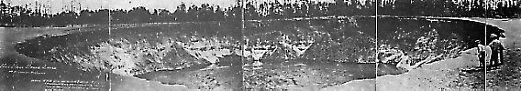

Slide 17
Historic Waste and Contamination
Earthen storage pits were used for the crude oil. From 1922 to 1934, up to eight percent of the oil produced was wasted, and almost all of the natural gas escaped.

Slide 18
Powers of ADEQ/APC&EC
§ 8-1-201. Purpose of subchapter
(a) The General Assembly recognizes that since 1949, when the precursor of the Arkansas Pollution Control and Ecology Commission was first created, significant changes have occurred in the responsibilities charged to the state's environmental agency. This subchapter intends to clarify and supersede prior law that does not comport with this delineation of responsibility between the Arkansas Department of Environmental Quality and the Arkansas Pollution Control and Ecology Commission.
(b) Further, in delineating the responsibility between the department and the commission, it is the intent of the General Assembly neither to expand nor to diminish any rights of property owners of this state under Arkansas Constitution, Article 2, § 22.

Slide 19
Water Pollution
§ 8-4-201. Powers and duties
. . .
(b) The Arkansas Pollution Control and Ecology Commission is given and charged with the following powers and duties:
(1)(A) Promulgation of rules and regulations, including water quality standards and the classification of the waters of the state and moratoriums or suspensions of the processing of types or categories of permits, implementing the substantive statutes charged to the department for administration.
. . .

Slide 20
Former Facilities Location w/ Brine Impacts

Slide 21
Air Pollution Subsection
§ 8-4-301. Public Policy
(a) In the interest of the public health and welfare of the people, it is declared to be the public policy of the State of Arkansas to maintain such a reasonable degree of purity of the air resources of the state to the end that the least possible injury should be done to human, plant, or animal life or to property and to maintain public enjoyment of the state's natural resources, consistent with the economic and industrial well-being of the state.
(b) The program for the control of air pollution under this chapter shall be undertaken in a progressive manner, and each of its successive objectives shall be sought to be accomplished by a maximum of cooperation and conciliation among all the parties concerned.

Slide 22
Historic Air Pollution Concerns

Slide 23
Collaborative Federalism
As a general matter, U.S. EPA and state governments collaborate on environmental protection.
In many cases, states enforce federal standards, or standards that must be as rigorous as federal standards.
The states now conduct between 80% and 90% of all environmental enforcement actions, while more than 75% of the major delegable environmental programs have been delegated to or assumed by the states.
The justification for this devolution of enforcement authority largely stems from the simple matter of proximity to the local environment.
States typically can respond more quickly to local pollution problems, better understand environmental conditions, have more everyday interaction with the regulated community, and can be more innovative and flexible in their solutions.

Slide 24
A Confession
I made the assumption that Arkansas was not terribly proactive in addressing environmental issues.

Slide 25
Arkansas & The Environment
Act 472 of 1949 - Arkansas Water Pollution Control Commission (response to 1948 Federal Water Pollution Control Act)
Act 183 of 1965 - became the Arkansas Pollution Control Commission and began regulating air pollution (2 years before Clean Air Act)
1971 - Arkansas Department of Pollution Control & Ecology began regulating solid waste disposal and open cut mining
1979 - began regulating hazardous waste (1/25/1985 authorization to implement base hazardous waste management program from EPA)
1989 - began regulating underground petroleum storage tanks
1999 - the ADPC&E became the Arkansas Department of Environmental Quality
Notes:
Act 472 of 1949 -- Established the Water Pollution Control Commission as a part of the State Board of Health. Its original membership consisted of the directors of four state agencies: the State Board of Health, the Arkansas Game and Fish Commission, the Arkansas Oil and Gas Commission and the Resources and Development Commission. The Commission also had three citizen members, each appointed by the Governor to represent interest areas of industry, municipalities and agriculture and livestock.
Act 232 of 1953 -- Added to the Commission members the director of the State Forestry and Parks Commission.
Act 503 of 1963 -- Required the Commission to appoint a director "who shall handle such correspondence make and arrange such inspections or investigations, and obtain and assemble or propose such reports and data as the Commission may direct and authorize, and who shall be the executive officer and active administrator of all pollution control activities and shall have such other delegated powers and duties as the Commission may direct or authorize."
Act 183 of 1965 -- Changed the Commission's name to the Arkansas Pollution Control Commission, added authority for air pollution control, removed the Commission from the Health Department and changed the state agency membership. The new composition of the Commission included the directors of five state agencies: the State Board of Health, the Arkansas Game and Fish Commission, the Oil and Gas Commission, the Natural Resources Commission and the State Forestry Commission. The three appointed member representatives remained unchanged.
Act 236 of 1971 -- Added two members to the Commission: the State Geologist and a representative of the state's mining industry. The special-interest representative was appointed by the Governor.
Act 38 of 1971 -- State government reorganization act; created the Arkansas Department of Environmental Quality and provided that the Department Director would be nominated by the Commission and confirmed by the Governor with consent of the State Senate.
Act 930 of 1985 -- Added another member to the Commission and clarified the qualifications of one of the positions to be appointed by the Governor. The additional member, appointed by the Governor, was required to be a member of an organization which belonged to the Arkansas Conservation Coalition. The change in the qualifications of another appointee, a representative of municipalities, was changed to the designation of a representative of city or county government.
Act 744 of 1991 -- Restructured the Commission as follows: Increased the size of the Commission to 13 members by adding two positions to be appointed by the Governor and removed the specific interest area designations for the gubernatorial appointees and required that private citizen appointees "... have knowledge or expertise in matters within the jurisdiction of the Commission including government, business or industry, agriculture and livestock, forestry, health, ecology, recreation and tourism and geology."
Other changes required each congressional district in the state to be represented by at least one of the seven private citizen appointees and provided that no district could have more than two appointees. Also, the act prohibited elected city, county or state officials from serving on the Commission after the expiration of any current member's term and prohibited the six state agency members from serving as chairman or vice chairman.
The new act required the presence of nine members as a quorum to conduct business, modified the procedures for issuance and revocation of wastewater discharge permits and for appeals of permit decisions involving wastewater discharges.
The changes also removed the selection of the Arkansas Department of Environmental Quality Director from the Commission's authority and placed the selection process directly with the Governor, subject to Senate confirmation.
Act 1230 of 1991 -- Clarified the powers and duties of the Commission and the ADEQ Director.
ADEQ’s first incarnation was the Arkansas Water Pollution Control Commission, created by Act 472 of 1949. Originally operating under the auspices of the Arkansas Department of Health, the commission was given the power to “administer and enforce all laws relating to the pollution of any waters in the State,” investigate pollution, establish pollution standards, and “prepare a comprehensive program for the elimination or reduction of pollution” in state waters. However, the commission comprised three gubernatorial appointees “representing industry, municipalities, and agriculture and livestock interests”—who often had little motivation to regulate pollution—as well as a member each from the State Board of Health, Game and Fish Commission, Oil and Gas Commission, and Resources and Development Commission.
Act 183 of 1965 changed the commission’s name to the Arkansas Pollution Control Commission and gave it the power to regulate air pollution; the act also made the commission a separate agency and expanded it from seven to eight members. It explicitly forbade, however, the commission from enforcing laws regarding agricultural operations, land clearing operations, road construction, and a few other such activities.
In 1971, the commission became the Department of Pollution Control and Ecology. During the 1970s, the department was given the responsibilities of regulating coal mining and hazardous waste disposal, and, in 1989, it was also made responsible for regulating underground petroleum tanks. In 1999, the department’s name was changed yet again, this time to the Arkansas Department of Environmental Quality. In 2007, ADEQ moved into its new headquarters in North Little Rock.
ADEQ maintains six regulatory divisions covering air, hazardous waste, mining, regulated storage tanks, solid waste, and water.

Slide 26
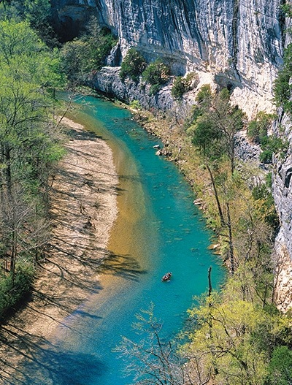
Important Example of Arkansas Environmental History
1938 - Buffalo River State Park
Eisenhower vetoed 2 attempts to dam the river
US Supreme Court Justice William O Douglas “The Buffalo River is a national treasure worth fighting to the death to preserve.”
March 1, 1972 - Nixon approved creation of the Buffalo National River
Notes:
exactly 100 years to the day after the establishment of Yellowstone - America’s first national park

Slide 27
Collaborative Federalism
As a general matter, U.S. EPA and state governments collaborate on environmental protection.
In many cases, states enforce federal standards, or standards that must be as rigorous as federal standards.
The states now conduct between 80% and 90% of all environmental enforcement actions, while more than 75% of the major delegable environmental programs have been delegated to or assumed by the states.
The justification for this devolution of enforcement authority largely stems from the simple matter of proximity to the local environment.
States typically can respond more quickly to local pollution problems, better understand environmental conditions, have more everyday interaction with the regulated community, and can be more innovative and flexible in their solutions.

Slide 28
Arkansas Pollution Control & Ecology Commission
Arkansas Water Pollution Control Act - enacted in 1949 and amendments related to water in 1993, 1997 and 1999
Became the Arkansas Water and Air Pollution Control Act - 1965
Nothing really specific to the O&G industry in statute
APC&EC Regulation No. 1, No. 17 and No. 34 are specific to O&G

Slide 29
APC&EC Reg. No. 1
No discharge of salt water or other oilfield waste to waters of the State
Preference for injection of salt water as a means of disposal
Any disposal requires a permit - which they won’t give you unless its for injection!

Slide 30
APC&EC Reg. No. 17
Underground Injection Control regulations
Essentially the responsibility for injection wells is divided between ADEQ (everything above the ground) and AOGC (everything downhole)
Subject to a MOU w/ ADEQ/AOGC and EPA

Slide 31
APC&EC Reg. No. 34
“State Water Permit Regulation”
Permit Requirements for Construction, Operation, and Closure of Pits Associated with Oil and Gas Wells and Brine Production and Injection Wells
Compliance with AOGC General Rule B-17 is deemed compliance with Reg. No. 34 so you don’t have to do anything special, ADEQ just gets to fine you under the reg if you discharge to waters of the State

Slide 32
Lots of General Environmental Regulations - ADEQ’s Bread & Butter
Air
Water
Waste
Predominately related to underlying Clean Air Act, Clean Water Act and Resource Conservation and Recovery Act

Slide 33
ADEQ Response to Fayetteville Shale Discovery
Really Two Issues
  Air Regulation Changes
    Driven by EPA NESHAP & MACT Rules
    General Permit for Gathering Facilities
  Regulation No. 34 (specific to O&G)
    to prevent water contamination

Slide 34
ADEQ was tasked with numerous research projects
State Legislature “asked” ADEQ to do lots of reporting and investigating
Air emissions inventories
  Estimated (based on analysis) to equal one large stationary source in 2008 (think power plant)
Water quality impacts
  Study actually done by USGS/AOGC/Duke U. /ANRC/UofA
Waste disposal issues
  Landfarms became a real issue for the department (2009 study) and were essentially run out of the State

Slide 35
AOGC Response to Fayetteville Shale
Lots of Rule Changes
Lots of Reporting to the Legislature
Lots of Inspections

Slide 36
AOGC Rule Changes
74 AOGC Rules existed in 1991
75 AOGC Rules in 2003
39 rules amended since 2003
80 total amendments since 2003
21 rules added since 2003
Over 200 pages of rules today
And a STRONGER review which went very well

Slide 37
AOGC Legislative Issues
FY2011/2012 AOGC Appropriation requires AOGC to report quarterly to the Legislature
Notice of Noncompliance
Notice of Violation
Summary of Inspections/Audits
  from ~ 2,200 2nd Quarter 2011 to over 3,900 in 2nd Quarter 2014
Summary of AOGC Hearings
  Integrations
  AOGC Staff Applications for Violations

Slide 38
In Summary - ADEQ
ADEQ
  Further along that anticipated
  Less work to “keep up” than expected
  Federal regs provided a good base for industry specific air requirements, but Arkansas’ historic protection of the environment limited the need for specific changes

Slide 39
In Summary - AOGC
AOGC made many, many changes
Necessary to address technical advancements
Necessary to maximize production (B-43)
Substantial increase in inspections/audits

Slide 40
Questions / Comments

